Slide 1
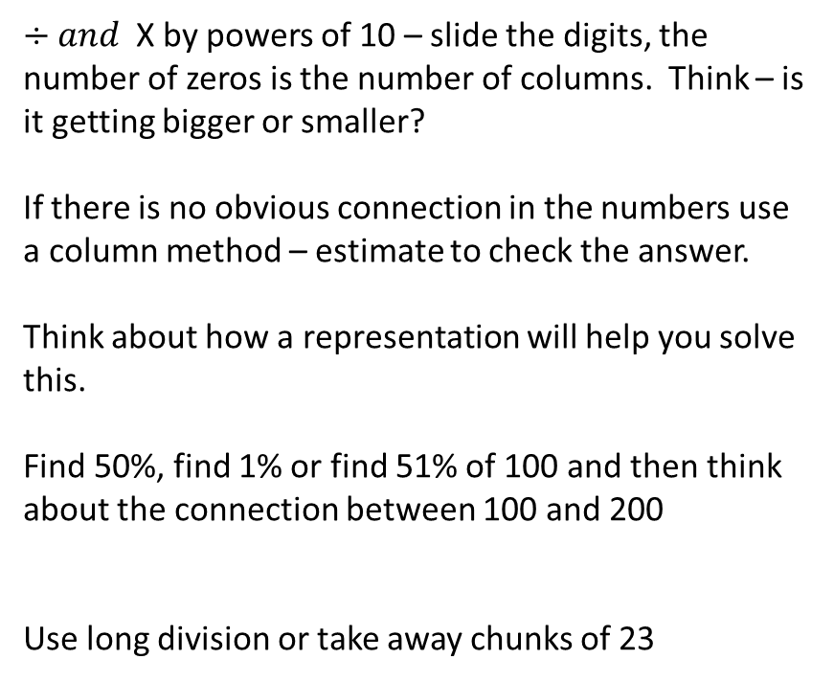
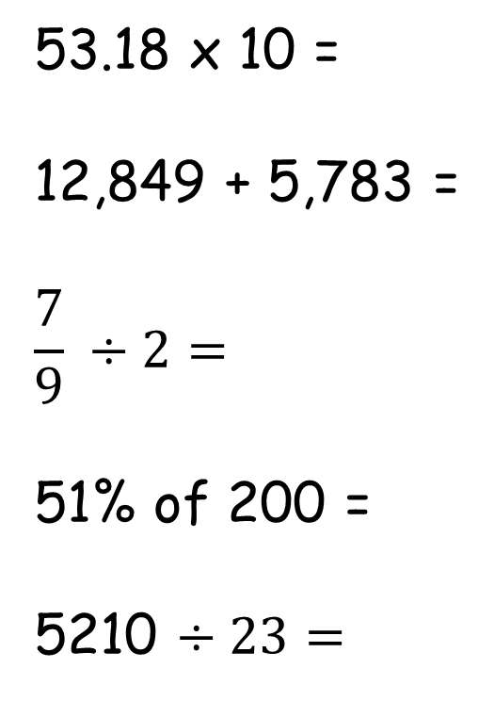
Tool Kit list
Pencil
Purple Pen
Whiteboard
Whiteboard pen
Glue
Pen
Ruler
Remember to check your tool kit has everything you need for the day.
53.18 x 10 =
12,849 + 5,783 =
$$\frac{7}{9} ÷2=$$
51% of 200 =
5210 $÷23=$
$÷and$X by powers of 10 – slide the digits, the number of zeros is the number of columns. Think – is it getting bigger or smaller?
If there is no obvious connection in the numbers use a column method – estimate to check the answer.
Think about how a representation will help you solve this.
Find 50%, find 1% or find 51% of 100 and then think about the connection between 100 and 200
Use long division or take away chunks of 23

Slide 2
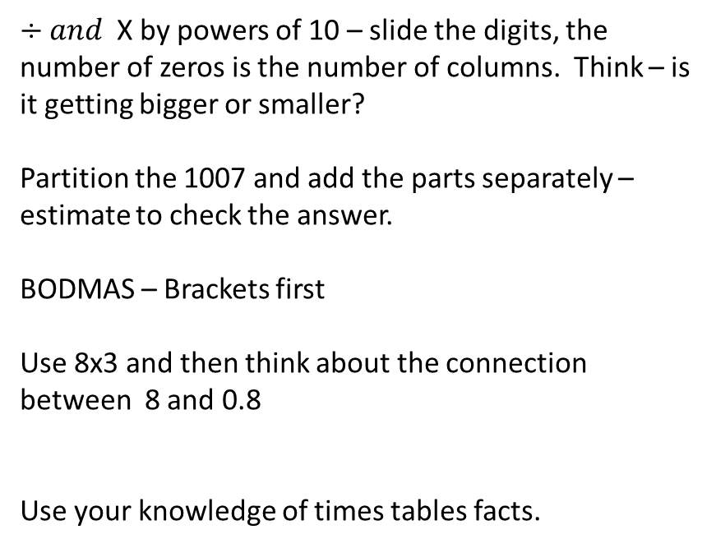
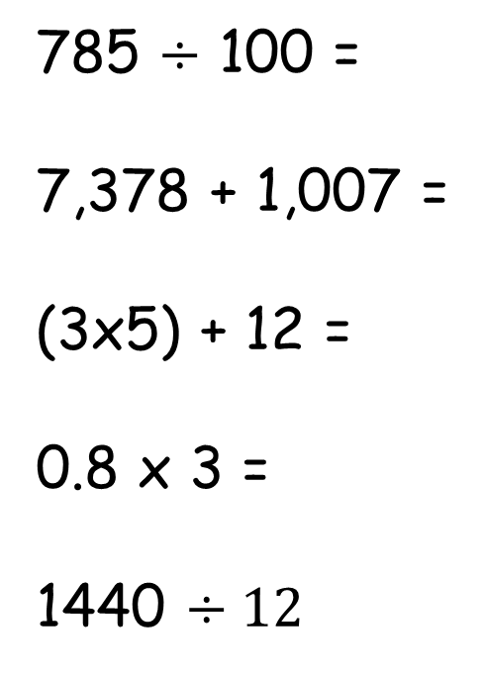
Tool Kit list
Pencil
Purple Pen
Whiteboard
Whiteboard pen
Glue
Pen
Ruler
Remember to check your tool kit has everything you need for the day.
785 $÷$ 100 =
7,378 + 1,007 =
(3x5) + 12 =
0.8 x 3 =
1440 $÷12$
$÷and$X by powers of 10 – slide the digits, the number of zeros is the number of columns. Think – is it getting bigger or smaller?
Partition the 1007 and add the parts separately – estimate to check the answer.
BODMAS – Brackets first
Use 8x3 and then think about the connection between 8 and 0.8
Use your knowledge of times tables facts.

Slide 3
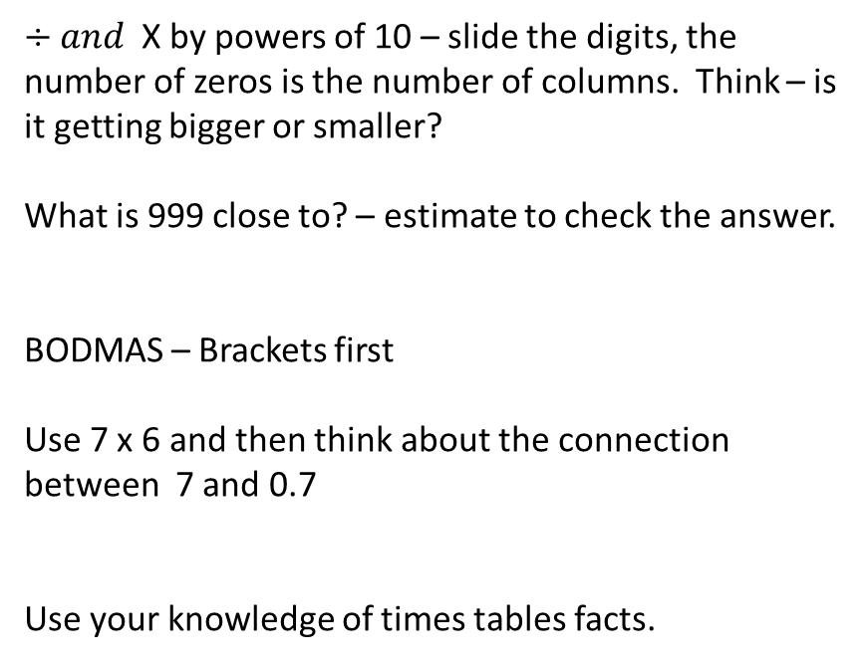
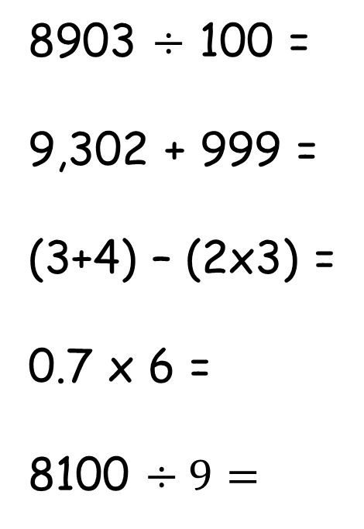
Tool Kit list
Pencil
Purple Pen
Whiteboard
Whiteboard pen
Glue
Pen
Ruler
Remember to check your tool kit has everything you need for the day.
8903 $÷$ 100 =
9,302 + 999 =
(3+4) – (2x3) =
0.7 x 6 =
8100 $÷9=$
$÷and$X by powers of 10 – slide the digits, the number of zeros is the number of columns. Think – is it getting bigger or smaller?
What is 999 close to? – estimate to check the answer.
BODMAS – Brackets first
Use 7 x 6 and then think about the connection between 7 and 0.7
Use your knowledge of times tables facts.

Slide 4
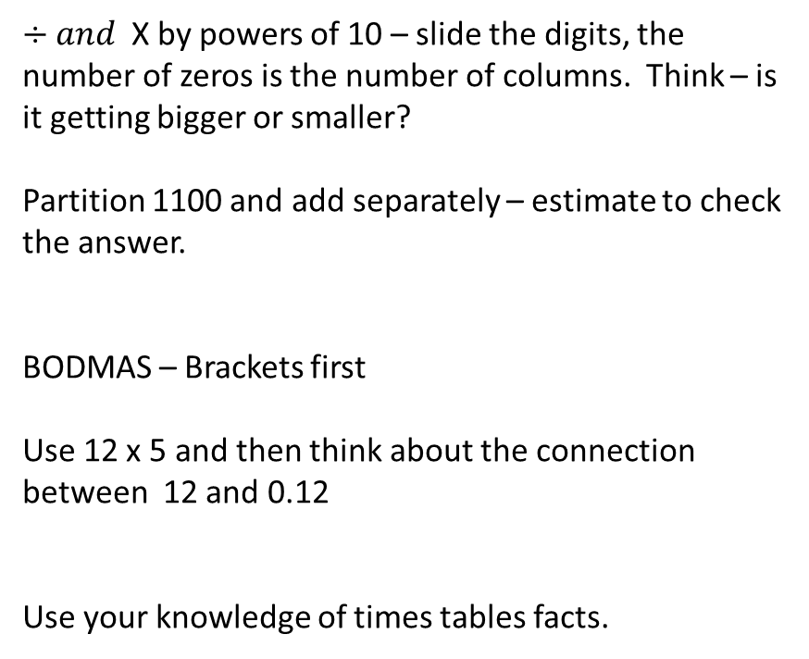
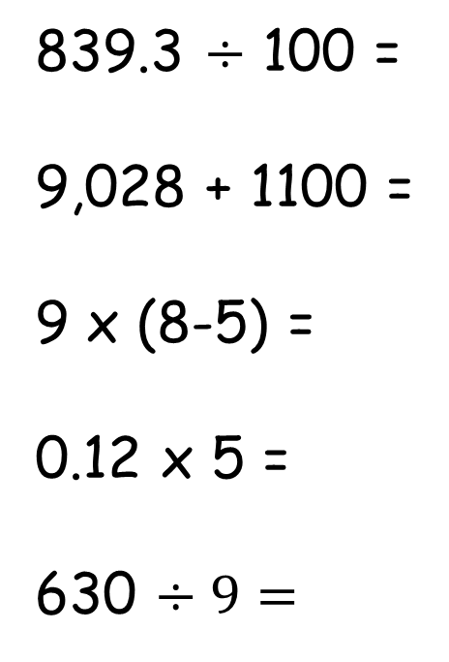
Tool Kit list
Pencil
Purple Pen
Whiteboard
Whiteboard pen
Glue
Pen
Ruler
Remember to check your tool kit has everything you need for the day.
839.3 $÷$ 100 =
9,028 + 1100 =
9 x (8-5) =
0.12 x 5 =
630 $÷9=$
$÷and$X by powers of 10 – slide the digits, the number of zeros is the number of columns. Think – is it getting bigger or smaller?
Partition 1100 and add separately – estimate to check the answer.
BODMAS – Brackets first
Use 12 x 5 and then think about the connection between 12 and 0.12
Use your knowledge of times tables facts.

Slide 5
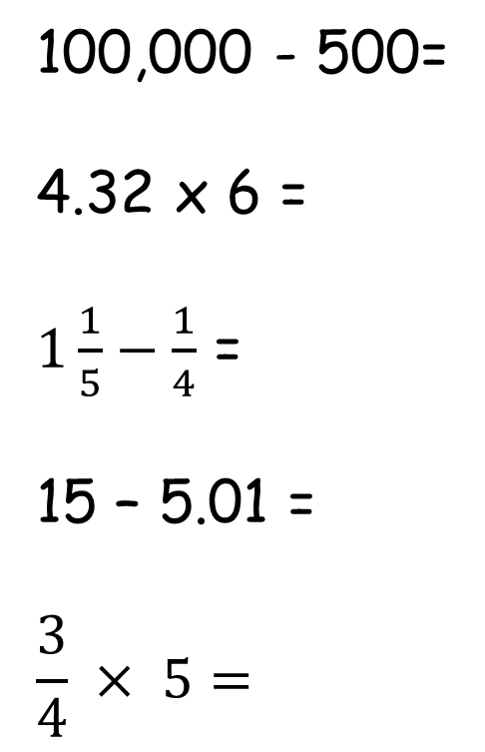
Tool Kit list
Pencil
Purple Pen
Whiteboard
Whiteboard pen
Glue
Pen
Ruler
Remember to check your tool kit has everything you need for the day.
100,000 - 500=
4.32 x 6 =
$1\frac{1}{5}−\frac{1}{4}$ =
15 – 5.01 =
$$\frac{3}{4} × 5=$$
If you don’t know the answer, think about using continuous difference to help you solve.
Partition 4.32 and multiply each number – estimate to check the answer.
You will need to make the denominators the same and turn the 1 whole into a fraction.
Partition the 5.01 and subtract them separately
Think of it as 3 quarters x 5 how many quarters would you have?

Slide 6
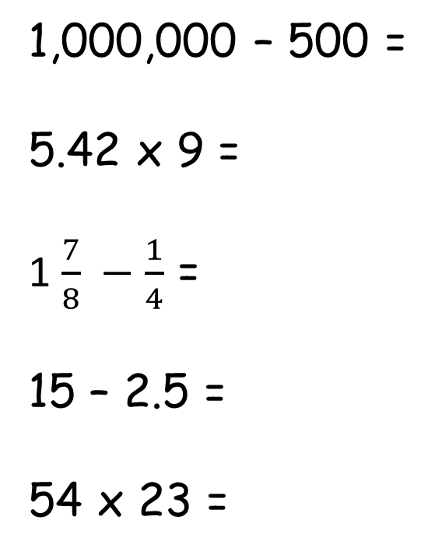
Tool Kit list
Pencil
Purple Pen
Whiteboard
Whiteboard pen
Glue
Pen
Ruler
Remember to check your tool kit has everything you need for the day.
1,000,000 – 500 =
5.42 x 9 =
1 $\frac{7}{8} −\frac{1}{4}$ =
15 – 2.5 =
54 x 23 =
Use continuous difference subtract 1 from each number
Partition the digits and multiply each one
How many eighths is one quarter?
Subtract the 2 and then the 0.5
If you don’t know how to use a column method think about partitioning each number.

Slide 7
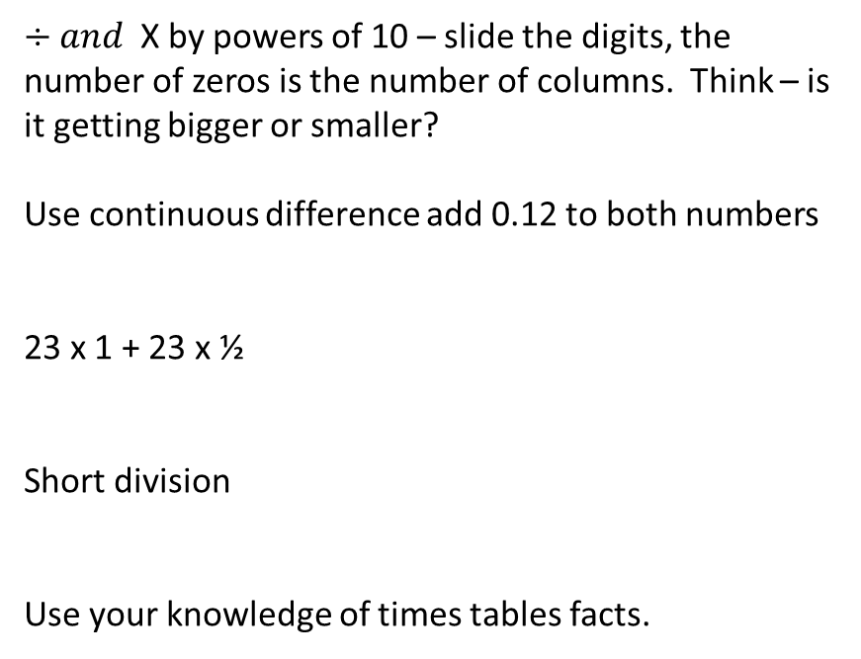
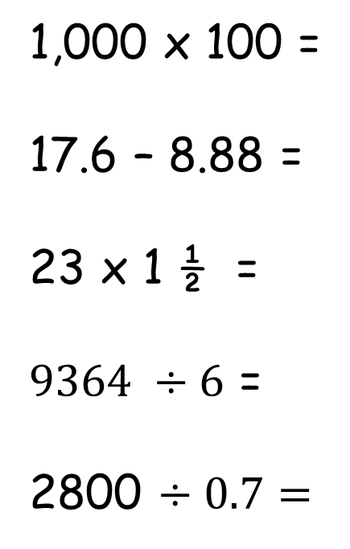
Tool Kit list
Pencil
Purple Pen
Whiteboard
Whiteboard pen
Glue
Pen
Ruler
Remember to check your tool kit has everything you need for the day.
1,000 x 100 =
17.6 – 8.88 =
23 x 1 ½ =
$9364 ÷6$ =
2800 $÷0.7=$
$÷and$X by powers of 10 – slide the digits, the number of zeros is the number of columns. Think – is it getting bigger or smaller?
Use continuous difference add 0.12 to both numbers
23 x 1 + 23 x ½
Short division
Use your knowledge of times tables facts.

Slide 8
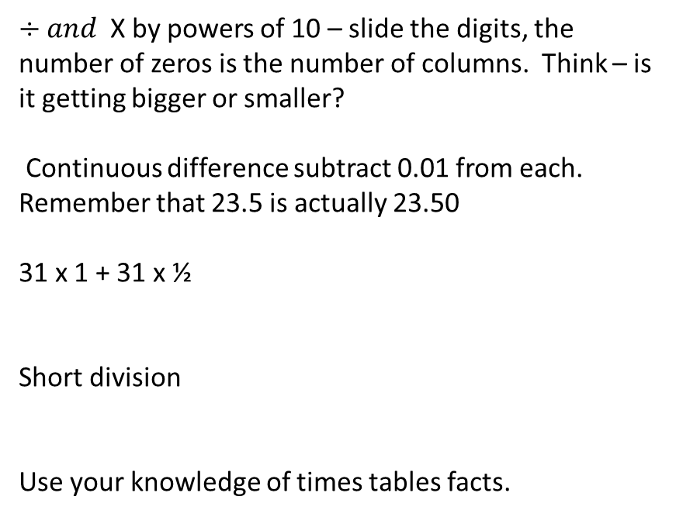
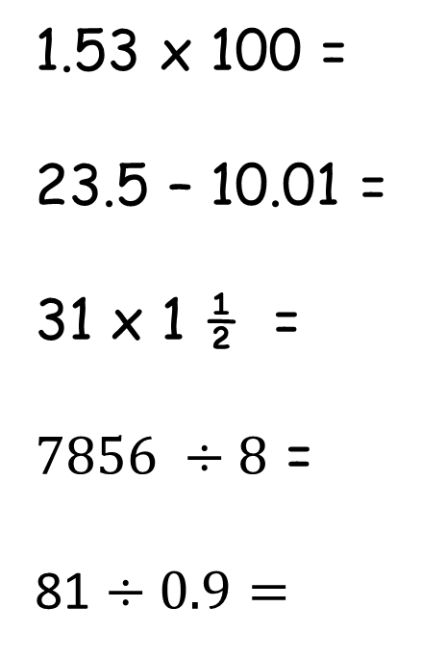
Tool Kit list
Pencil
Purple Pen
Whiteboard
Whiteboard pen
Glue
Pen
Ruler
Remember to check your tool kit has everything you need for the day.
1.53 x 100 =
23.5 – 10.01 =
31 x 1 ½ =
$7856 ÷8$ =
81 $÷0.9=$
$÷and$X by powers of 10 – slide the digits, the number of zeros is the number of columns. Think – is it getting bigger or smaller?
Continuous difference subtract 0.01 from each. Remember that 23.5 is actually 23.50
31 x 1 + 31 x ½
Short division
Use your knowledge of times tables facts.

Slide 9
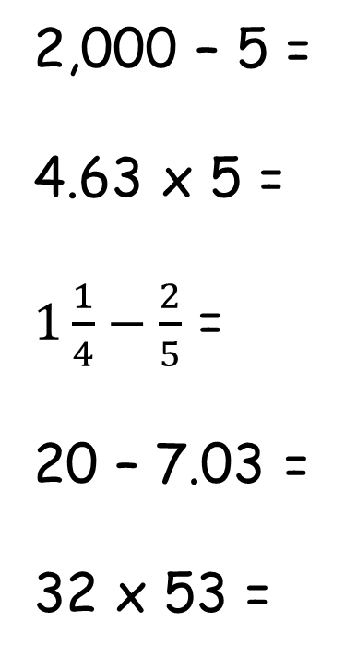
Tool Kit list
Pencil
Purple Pen
Whiteboard
Whiteboard pen
Glue
Pen
Ruler
Remember to check your tool kit has everything you need for the day.
2,000 – 5 =
4.63 x 5 =
$1\frac{1}{4}−\frac{2}{5}$ =
20 – 7.03 =
32 x 53 =
Use continuous difference subtract 1 from each number
Partition the digits and multiply each one
Fifths and quarters will need to be made into twentieths . You will also need to change the 1 whole into 20ths
Subtract 7 and then 0.03
If you don’t know how to use a column method think about partitioning each number.

Slide 10
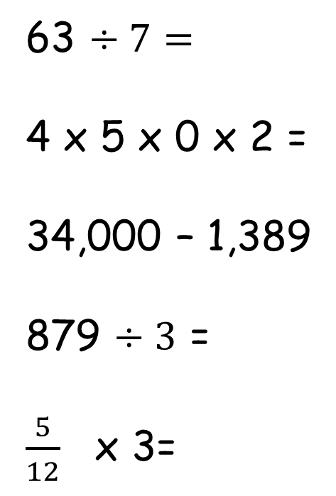
Tool Kit list
Pencil
Purple Pen
Whiteboard
Whiteboard pen
Glue
Pen
Ruler
Remember to check your tool kit has everything you need for the day.
63 $÷7=$
4 x 5 x 0 x 2 =
34,000 – 1,389
879 $÷3$ =
$\frac{5}{12}$ x 3=
Use your times table facts
Look carefully at the numbers
Use continuous difference
Short division
You have 3 lots of 5 twelfths . If you had 3 lots of 5 ones the ones wouldn’t change so the twelfths doesn’t

Slide 11
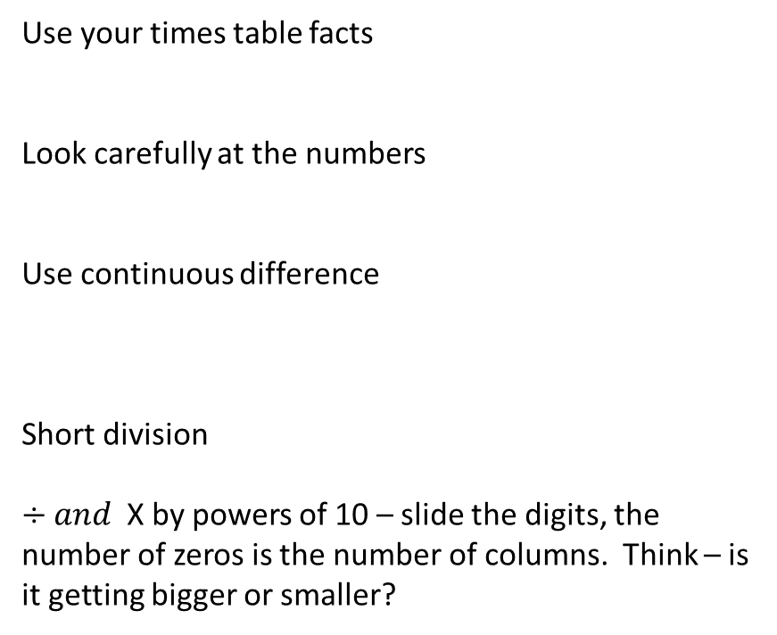
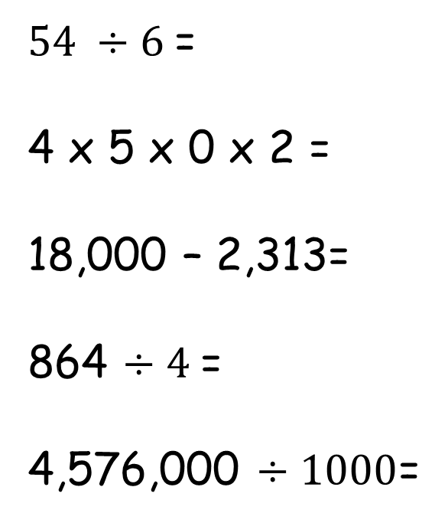
Tool Kit list
Pencil
Purple Pen
Whiteboard
Whiteboard pen
Glue
Pen
Ruler
Remember to check your tool kit has everything you need for the day.
$54 ÷6$=
4 x 5 x 0 x 2 =
18,000 – 2,313=
864 $÷4$=
4,576,000 $÷1000$=
Use your times table facts
Look carefully at the numbers
Use continuous difference
Short division
$÷and$X by powers of 10 – slide the digits, the number of zeros is the number of columns. Think – is it getting bigger or smaller?

Slide 12
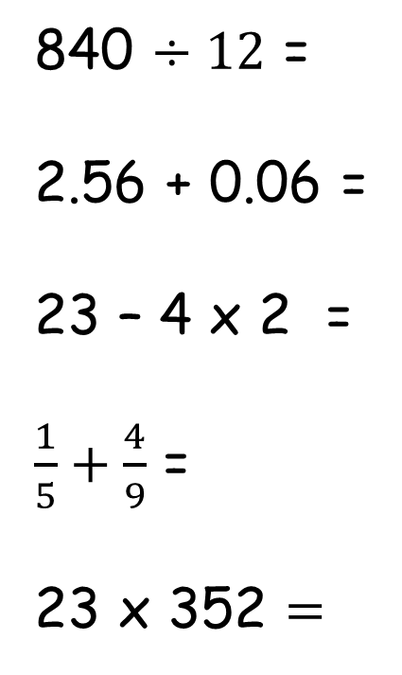
Tool Kit list
Pencil
Purple Pen
Whiteboard
Whiteboard pen
Glue
Pen
Ruler
840 $÷12$ =
2.56 + 0.06 =
23 – 4 x 2 =
$\frac{1}{5}+\frac{4}{9}$ =
23 x 352 $=$
Use your knowledge of times tables facts
Think about your columns which ones will be changed by this addition
BOMAS
Convert the fractions so that they have the same denominators
Use column multiplication. If you are not confident doing that use a grid to partition the numbers.

Slide 13
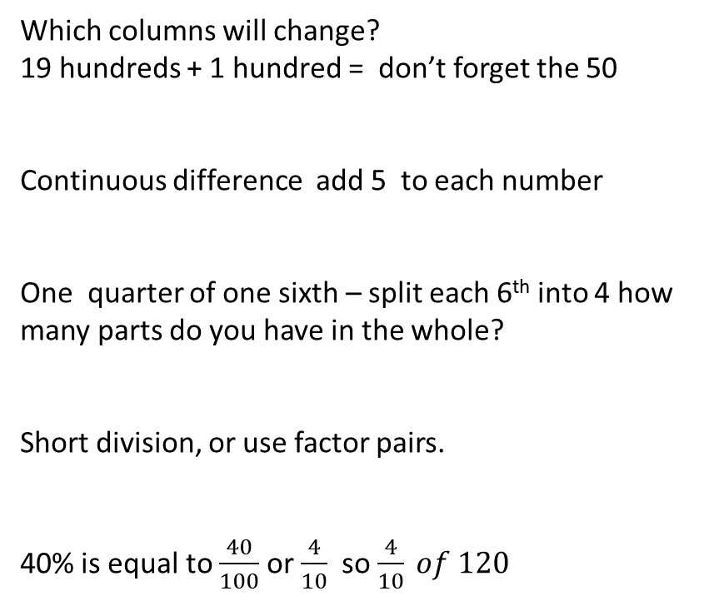
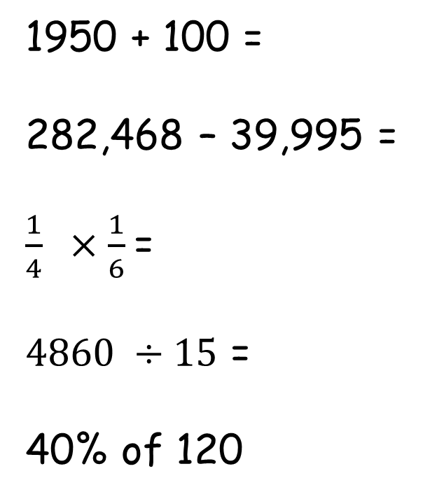
Tool Kit list
Pencil
Purple Pen
Whiteboard
Whiteboard pen
Glue
Pen
Ruler
Remember to check your tool kit has everything you need for the day.
1950 + 100 =
282,468 – 39,995 =
$\frac{1}{4} ×\frac{1}{6}$=
$4860 ÷15$ =
40% of 120
Which columns will change?
19 hundreds + 1 hundred = don’t forget the 50
Continuous difference add 5 to each number
One quarter of one sixth – split each 6th into 4 how many parts do you have in the whole?
Short division, or use factor pairs.
40% is equal to $\frac{40}{100}$ or $\frac{4}{10}$ so $\frac{4}{10} of 120$

Slide 14
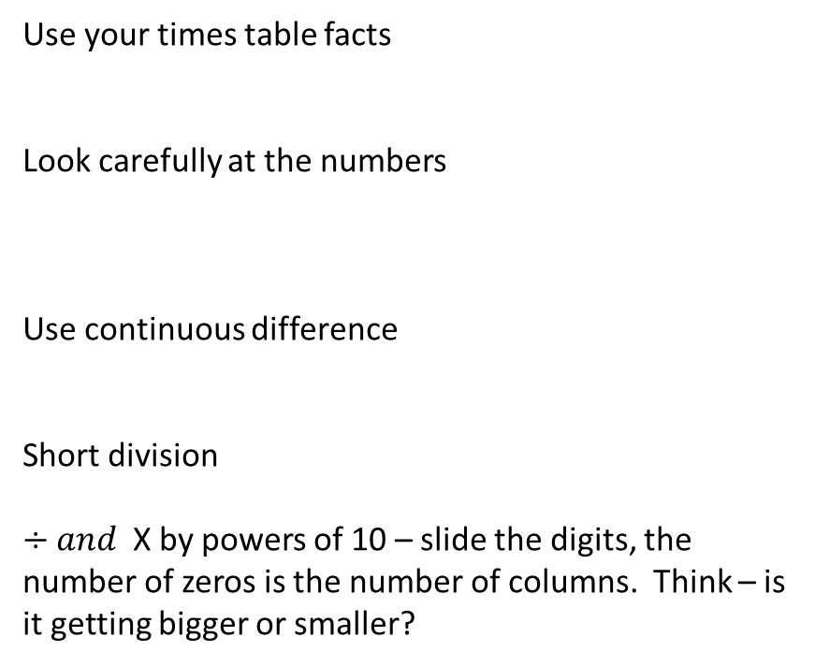
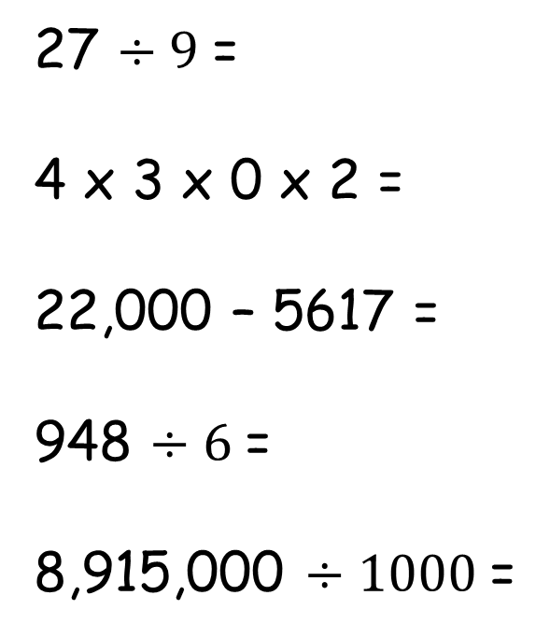
Tool Kit list
Pencil
Purple Pen
Whiteboard
Whiteboard pen
Glue
Pen
Ruler
Remember to check your tool kit has everything you need for the day.
27 $÷9$=
4 x 3 x 0 x 2 =
22,000 – 5617 =
948 $÷6$=
8,915,000 $÷1000$=
Use your times table facts
Look carefully at the numbers
Use continuous difference
Short division
$÷and$X by powers of 10 – slide the digits, the number of zeros is the number of columns. Think – is it getting bigger or smaller?

Slide 15
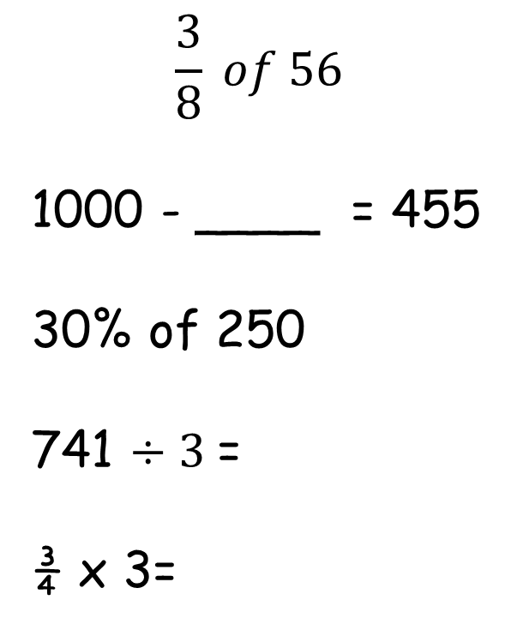
Tool Kit list
Pencil
Purple Pen
Whiteboard
Whiteboard pen
Glue
Pen
Ruler
Remember to check your tool kit has everything you need for the day.
$$\frac{3}{8} of 56$$
1000 - ____ = 455
30% of 250
741 $÷3$=
¾ x 3=
Divide by the denominator, multiple by the numerator
Number bonds – be careful there is some exchanging
Find 10% first
Short division
You have 3 lots of 3 quarters . If you had 3 lots of 4 ones the ones wouldn’t change so the quarters doesn’t, remember, multiplication is like repeated addition.

Slide 16
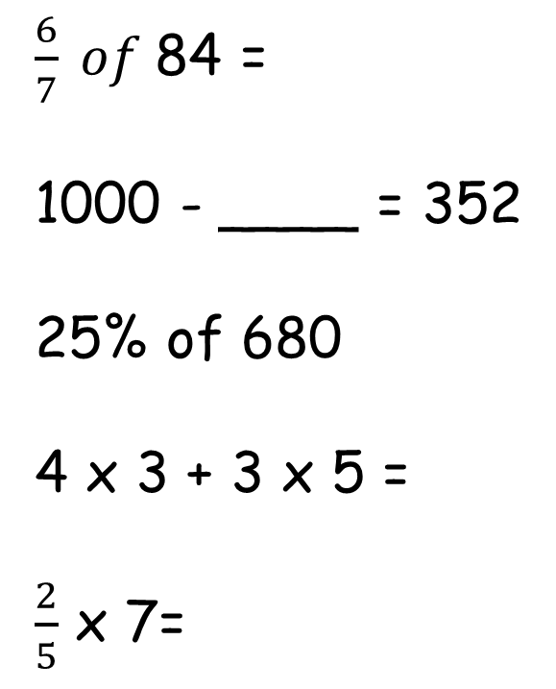
Tool Kit list
Pencil
Purple Pen
Whiteboard
Whiteboard pen
Glue
Pen
Ruler
Remember to check your tool kit has everything you need for the day.
$\frac{6}{7} of$84 =
1000 - ____ = 352
25% of 680
4 x 3 + 3 x 5 =
$\frac{2}{5}$ x 7=
Divide by the denominator, multiple by the numerator
Number bonds – be careful there is some exchanging
Find 10% and 5 % first
Bodmas
You have 7 lots of 2 fifths . If you had 7 lots of 2 ones the ones wouldn’t change so the fifths doesn’t , remember, multiplication is like repeated addition.

Slide 17
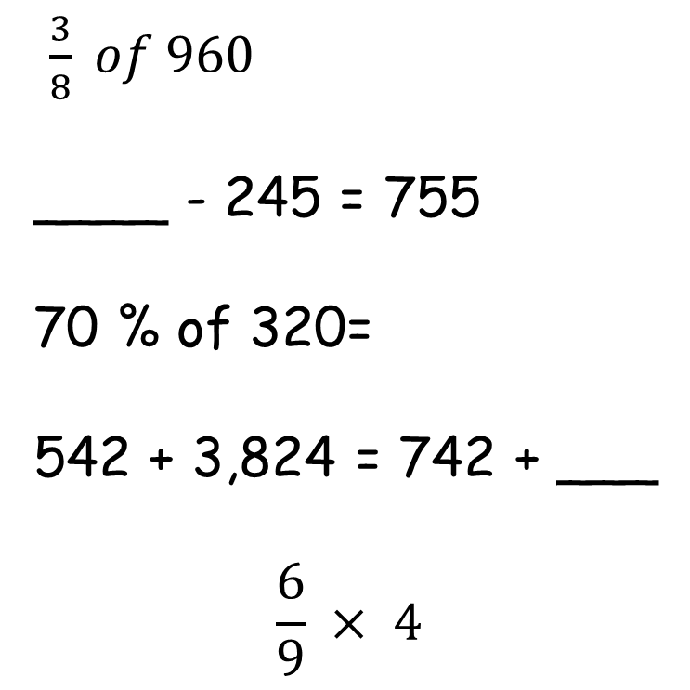
Tool Kit list
Pencil
Purple Pen
Whiteboard
Whiteboard pen
Glue
Pen
Ruler
Remember to check your tool kit has everything you need for the day.
$\frac{3}{8} of 960$
____ - 245 = 755
70 % of 320=
542 + 3,824 = 742 + ___
$$\frac{6}{9} × 4$$
Divide by the denominator, multiple by the numerator
Number bonds – be careful there is some exchanging
Find 10% first
What do you notice about the numbers?
You have 4 lots of 6 ninths . If you had 4 lots of 6 ones the ones wouldn’t change so the ninths doesn’t, remember, multiplication is like repeated addition.

Slide 18
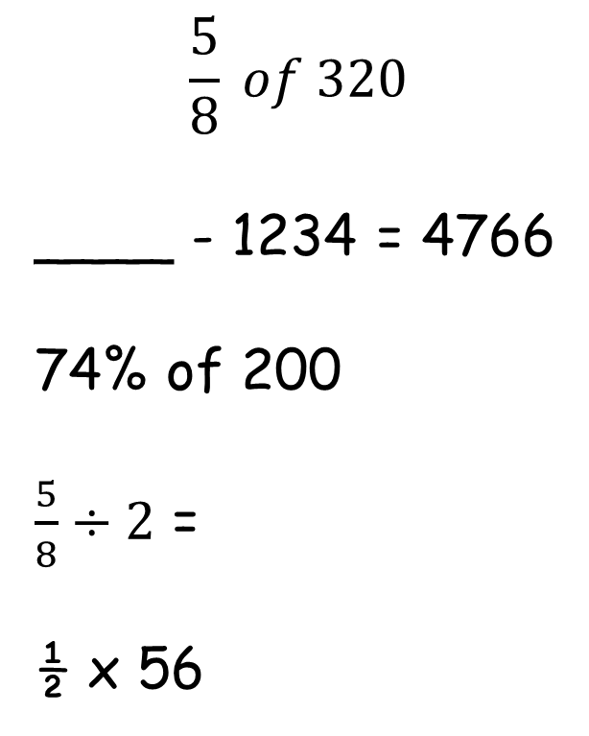
Tool Kit list
Pencil
Purple Pen
Whiteboard
Whiteboard pen
Glue
Pen
Ruler
Remember to check your tool kit has everything you need for the day.
$$\frac{5}{8} of 320$$
____ - 1234 = 4766
74% of 200
$\frac{5}{8}÷2$ =
½ x 56
Divide by the denominator, multiple by the numerator
Number bonds – be careful there is some exchanging
Find 10% and 1% first
Draw a bar model to help you
½ of 56

Slide 19
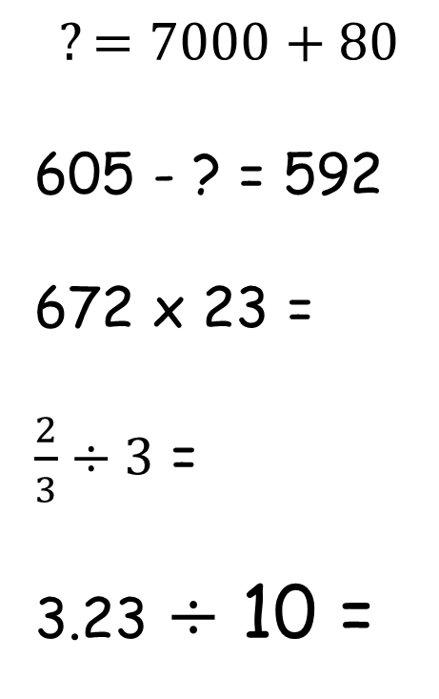
Tool Kit list
Pencil
Purple Pen
Whiteboard
Whiteboard pen
Glue
Pen
Ruler
Remember to check your tool kit has everything you need for the day.
$$?=7000+80$$
605 - ? = 592
672 x 23 =
$\frac{2}{3}÷3$ =
3.23 $÷$ 10 =
Think about your place value
What is the difference between the two numbers? Count up from the smaller number to find the difference.
Formal multiplication, remember zero as a place holder.
KFC, or remember, dividing by 3 is the same as a third of – what operation is the same as of…
Think place value chart, divide by 10 means sliding once down the place value chart (to the right once)

Slide 20
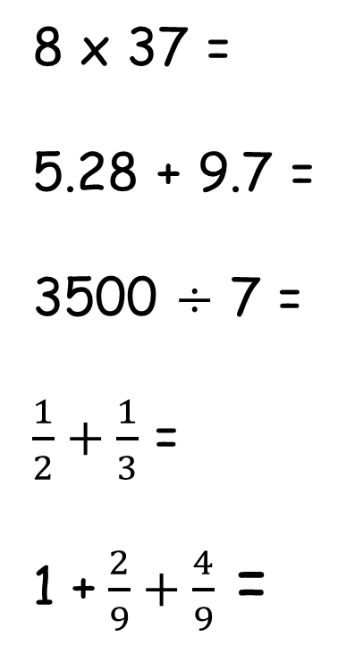
Tool Kit list
Pencil
Purple Pen
Whiteboard
Whiteboard pen
Glue
Pen
Ruler
Remember to check your tool kit has everything you need for the day.
8 x 37 =
5.28 + 9.7 =
3500 $÷$ 7 =
$\frac{1}{2}+\frac{1}{3}$ =
1 + $\frac{2}{9}+\frac{4}{9}$ =
Partition if you need to, otherwise formal multiplication.
Remember to line your decimal point up when doing this addition.
Think – what patterns do you notice, do you know your times tables? If you know that, what is this…
Remember, these fractions do not have the same denominator, so they cannot be added, you need to convert them to the lowest common multiple.
The denominators are the same, so you can add them without any converting.

Slide 21
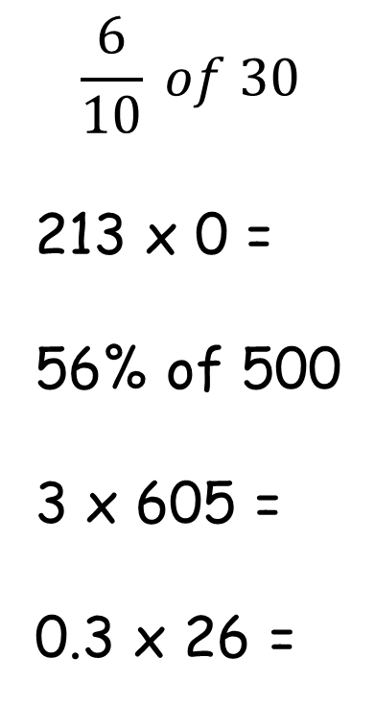
Tool Kit list
Pencil
Purple Pen
Whiteboard
Whiteboard pen
Glue
Pen
Ruler
Remember to check your tool kit has everything you need for the day.
$$\frac{6}{10} of 30$$
213 x 0 =
56% of 500
3 x 605 =
0.3 x 26 =
Divide by the denominator, multiply by the numerator (find one tenth, then find six of them)
What is anything multiplied by zero!
What is 100%? What is 50%? What is 5%? What is 1%? So, what is 56%...
Formal multiplication or repeated addition
Formal multiplication or repeated addition

Slide 22
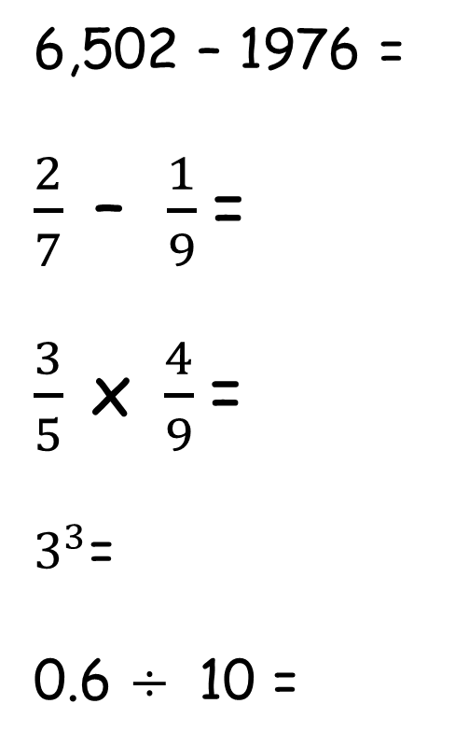
Tool Kit list
Pencil
Purple Pen
Whiteboard
Whiteboard pen
Glue
Pen
Ruler
Remember to check your tool kit has everything you need for the day.
6,502 – 1976 =
$\frac{2}{7}$– $\frac{1}{9}$=
$\frac{3}{5} \text{x} \frac{4}{9}$=
$3^{3}$=
0.6 $÷$ 10 =
Obviously exchanging needed – formal subtraction
The denominators are not the same, so you will need to find a common multiple and convert them before you subtract.
When you multiply fractions, remember you multiply the numerators to get the numerator and multiply the denominators to get the denominator.
Remember this is three cubed, so 3 x 3 x 3 =
Remember, dividing by ten means moving once down the place value chart (moving once right).

Slide 23

Tool Kit list
Pencil
Purple Pen
Whiteboard
Whiteboard pen
Glue
Pen
Ruler
Remember to check your tool kit has everything you need for the day.
630 $÷$9 =
15% of 4500 =
? = 10 x 94
9 – 1.8 =
925 $÷$37 =
Which times-table could you use to help you with this?
Work out 10% and then 5%.
Use your knowledge of x numbers by 10.
Use column method and line up your decimals.
Remember to use bus stop.

Slide 24
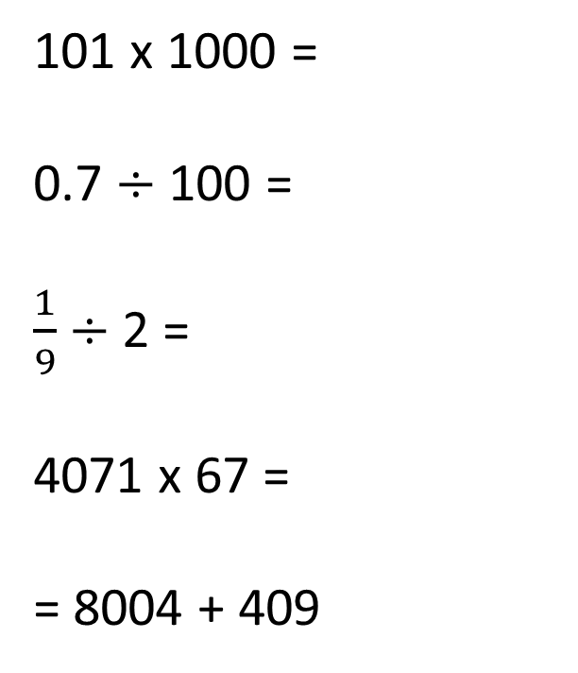
Tool Kit list
Pencil
Purple Pen
Whiteboard
Whiteboard pen
Glue
Pen
Ruler
Remember to check your tool kit has everything you need for the day.
101 x 1000 =
0.7 $÷$100 =
$\frac{1}{9}$ $÷$2 =
4071 x 67 =
= 8004 + 409
Think about columns when x by 1000 – how many columns would the number move and to the left or right?
What about when we divide by 100?
We are dividing a fraction by 2 – what does this do to the number?
Set this out as long multiplication – don't forget the place holder in row 2.
Set this out correctly using column method.

Slide 25
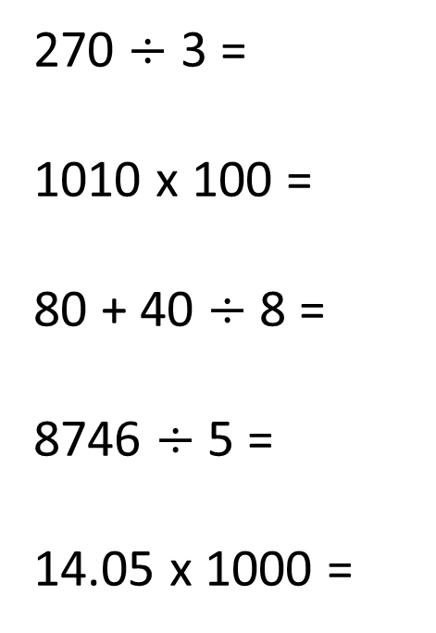
Tool Kit list
Pencil
Purple Pen
Whiteboard
Whiteboard pen
Glue
Pen
Ruler
Remember to check your tool kit has everything you need for the day.
270 $÷$ 3 =
1010 x 100 =
80 + 40 $÷$ 8 =
8746 $÷$ 5 =
14.05 x 1000 =
Use your knowledge of your three times table.
How many columns will this number move along and to the right or left?
BODMAS
Bus stop method.
What happens when we x a number by 1000?

Slide 26
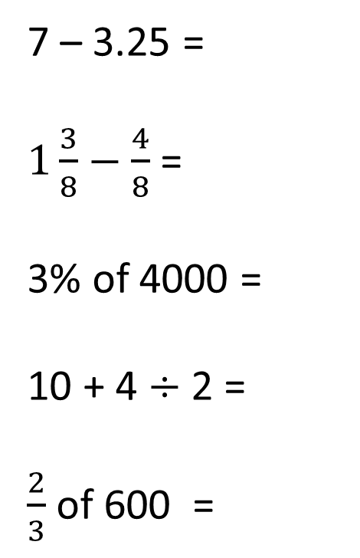
Tool Kit list
Pencil
Purple Pen
Whiteboard
Whiteboard pen
Glue
Pen
Ruler
Remember to check your tool kit has everything you need for the day.
7 – 3.25 =
$1\frac{3}{8}−\frac{4}{8}$ =
3% of 4000 =
10 + 4 $÷$ 2 =
$\frac{2}{3}$ of 600 =
Line up the decimal places.
Convert to an improper fraction (top heavy).
Find 1% first and then times by 3.
BODMAS.
Find 1/3 first.

Slide 27
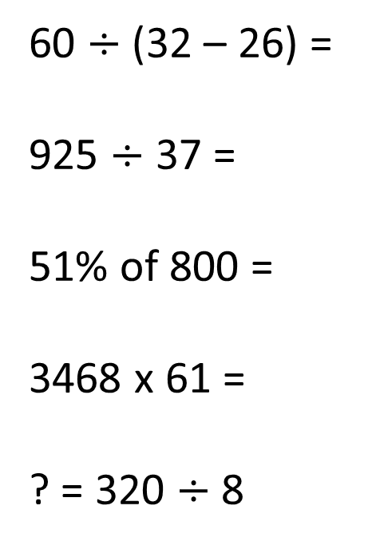
Tool Kit list
Pencil
Purple Pen
Whiteboard
Whiteboard pen
Glue
Pen
Ruler
Remember to check your tool kit has everything you need for the day.
60 $÷$ (32 – 26) =
925 $÷$ 37 =
51% of 800 =
3468 x 61 =
? = 320 $÷$ 8
BODMAS
Use the bus stop method
Find 10% and 1% first then times the 10% to get to 50%
Remember your place holder in row 2
Which times tables could help you with this?

Slide 28
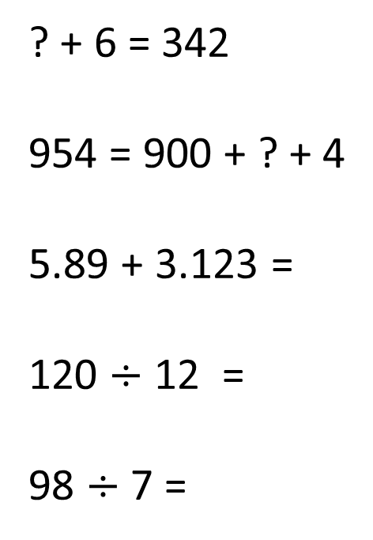
Tool Kit list
Pencil
Purple Pen
Whiteboard
Whiteboard pen
Glue
Pen
Ruler
Remember to check your tool kit has everything you need for the day.
? + 6 = 342
954 = 900 + ? + 4
5.89 + 3.123 =
120 $÷$ 12 =
98 $÷$ 7 =
Try inverse operation to help you.
Use your knowledge of place value
Make sure you line up your decimals correctly
Do you necessarily need to use bus stop this time?
Could your 7 times table help you?

Slide 29
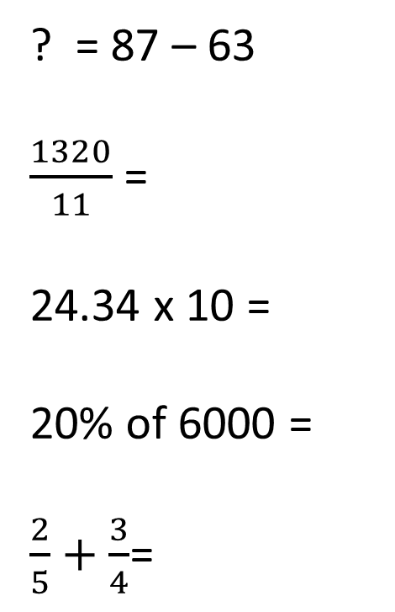
Tool Kit list
Pencil
Purple Pen
Whiteboard
Whiteboard pen
Glue
Pen
Ruler
Remember to check your tool kit has everything you need for the day.
? = 87 – 63
$\frac{1320}{11}$ =
24.34 x 10 =
20% of 6000 =
$\frac{2}{5}+\frac{3}{4}$=
Subtraction
Could your 11 times table help?
Remember, x by ten means moving once up the place value chart (moving once left).
Find 10% first
Make the denominators the same first, then you can work out the addition sum.

Slide 30
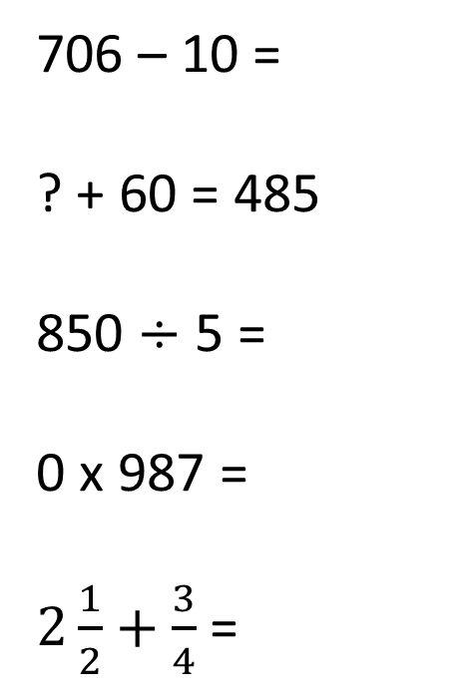
Tool Kit list
Pencil
Purple Pen
Whiteboard
Whiteboard pen
Glue
Pen
Ruler
Remember to check your tool kit has everything you need for the day.
706 – 10 =
? + 60 = 485
850 $÷$ 5 =
0 x 987 =
$2\frac{1}{2}+\frac{3}{4}$ =
Remember about crossing the 100 when taking away.
Use the inverse operation.
Use bus stop method.
What do you know is the answer when you x any number by 0?
Do you always need to make the denominators the same?

Slide 31
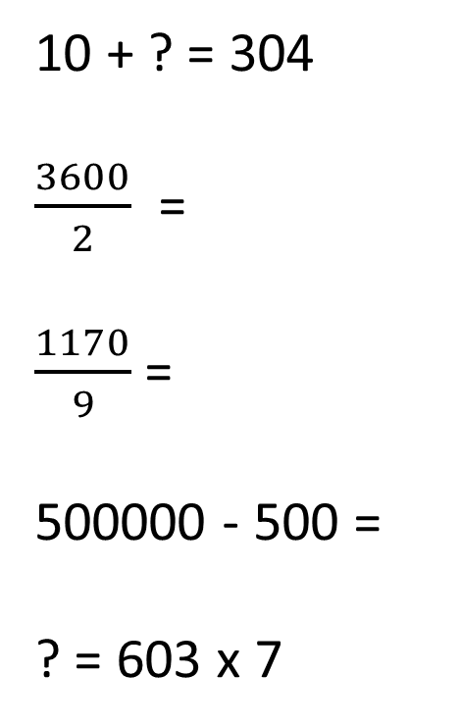
Tool Kit list
Pencil
Purple Pen
Whiteboard
Whiteboard pen
Glue
Pen
Ruler
Remember to check your tool kit has everything you need for the day.
10 + ? = 304
$\frac{3600}{2}$ =
$\frac{1170}{9}$ =
500000 - 500 =
? = 603 x 7
Cross the 100 barrier – think carefully.
What times table could you use to help you?
Bus stop method
Use column addition, don't just assume you can work this out in your head.
Long multiplication

Slide 32
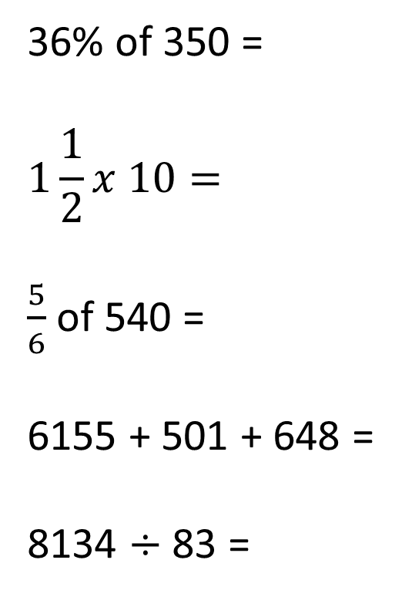
Tool Kit list
Pencil
Purple Pen
Whiteboard
Whiteboard pen
Glue
Pen
Ruler
Remember to check your tool kit has everything you need for the day.
36% of 350 =
$$1\frac{1}{2}x 10=$$
$\frac{5}{6}$ of 540 =
6155 + 501 + 648 =
8134 $÷$ 83 =
Find 10% then find 1%
Work out half of 10 first of all.
Find 1 sixth and then times by 5.
Column addition
Bus stop method

Slide 33
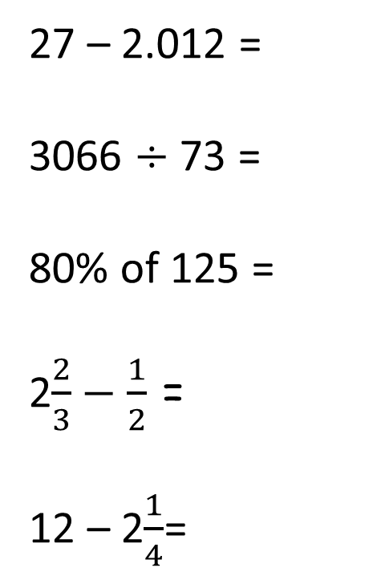
Tool Kit list
Pencil
Purple Pen
Whiteboard
Whiteboard pen
Glue
Pen
Ruler
Remember to check your tool kit has everything you need for the day.
27 – 2.012 =
3066 $÷$73 =
80% of 125 =
2$\frac{2}{3}−\frac{1}{2}$ =
12 – 2$\frac{1}{4}$=
Column subtraction
Bus stop method
Find 10% first
Make denominators the same or draw a bar model to help you
Draw a bar model to help you.

Slide 34
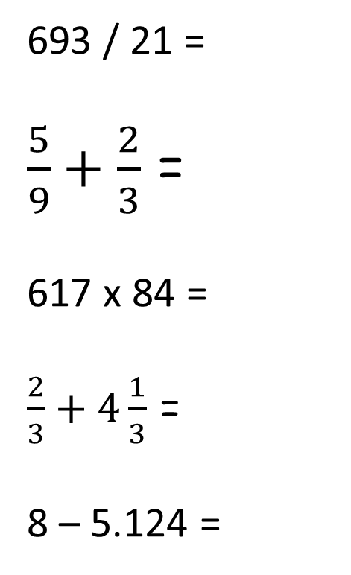
Tool Kit list
Pencil
Purple Pen
Whiteboard
Whiteboard pen
Glue
Pen
Ruler
Remember to check your tool kit has everything you need for the day.
693 / 21 =
$\frac{5}{9}+\frac{2}{3}$ =
617 x 84 =
$\frac{2}{3}+4\frac{1}{3}$ =
8 – 5.124 =
Long division – you will need to write out your 21 times table up to 5 x 21.
Make the denominators the same.
Long Multiplication
Can you just work this out? Draw bar model to help if not.
Set out as column subtraction.

