Slide 1
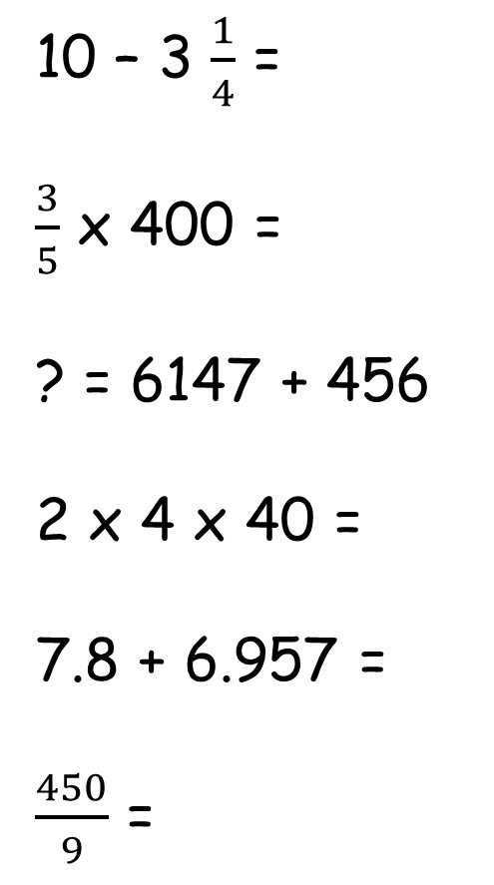
Tool Kit list
Pencil
Purple Pen
Whiteboard
Whiteboard pen
Glue
Pen
Ruler
Remember to check your tool kit has everything you need for the day.
10 – 3 $\frac{1}{4}$ =
$\frac{3}{5}$ x 400 =
? = 6147 + 456
2 x 4 x 40 =
7.8 + 6.957 =
$\frac{450}{9}$ =
Take away the whole number first then think how you will take away the remaining fraction.
Find 1/5 then think how many times you need to times this number by.
Column addition
Times the first two numbers then that answer times by the final number.
Line up the numbers correctly as column addition.
What times table could you use to help you?

Slide 2
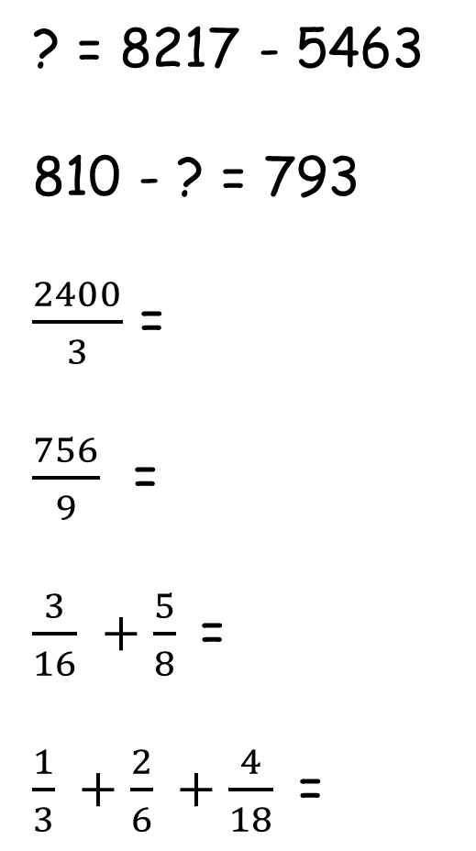
Tool Kit list
Pencil
Purple Pen
Whiteboard
Whiteboard pen
Glue
Pen
Ruler
Remember to check your tool kit has everything you need for the day.
? = 8217 - 5463
810 - ? = 793
$\frac{2400}{3}$ =
$\frac{756}{9}$ =
$\frac{3}{16} +\frac{5}{8}$=
$\frac{1}{3} +\frac{2}{6} +\frac{4}{18}$=
Column subtraction
What subtraction calculation could you do to give you the missing number?
What times table could you use to help you with the next 2 questions?
Make the denominators the same and then work out the addition calculations.

Slide 3
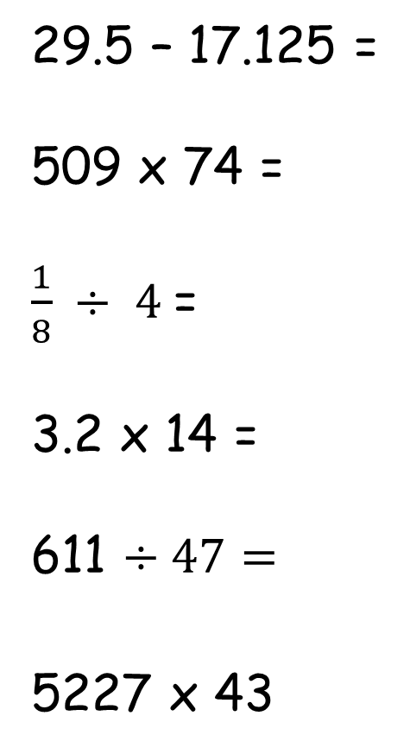
Tool Kit list
Pencil
Purple Pen
Whiteboard
Whiteboard pen
Glue
Pen
Ruler
Remember to check your tool kit has everything you need for the day.
29.5 – 17.125 =
509 x 74 =
$\frac{1}{8} ÷ 4$=
3.2 x 14 =
611 $÷47=$
5227 x 43
Set out this correctly as column subtraction – remember biggest number always goes on top.
Long multiplication – don’t forget the place holder on line 2.
Times the denominator by the whole number, keep the numerator the same.
Remove the decimal point, work out the division sum and then add in the decimal point.
Bus stop method.
Long multiplication – don’t forget the place holder on line 2.

Slide 4
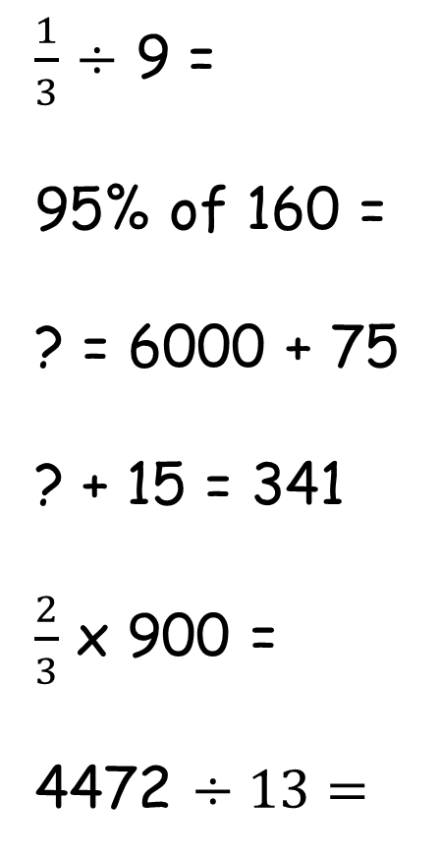
Tool Kit list
Pencil
Purple Pen
Whiteboard
Whiteboard pen
Glue
Pen
Ruler
Remember to check your tool kit has everything you need for the day.
$\frac{1}{3}$ $÷$ 9 =
95% of 160 =
? = 6000 + 75
? + 15 = 341
$\frac{2}{3}$ x 900 =
4472 $÷13=$
Remember to x the denominator by the whole number and leave the numerator the same.
Find 5% (by finding 10% and halving) and then take away from 160.
Simple addition – which columns need changing?
Work out the inverse (subtractrion) to help you.
X a fraction is the same as of – what is 2/3 OF 900? Find 1 third and double it.
Bus stop method.

Slide 5
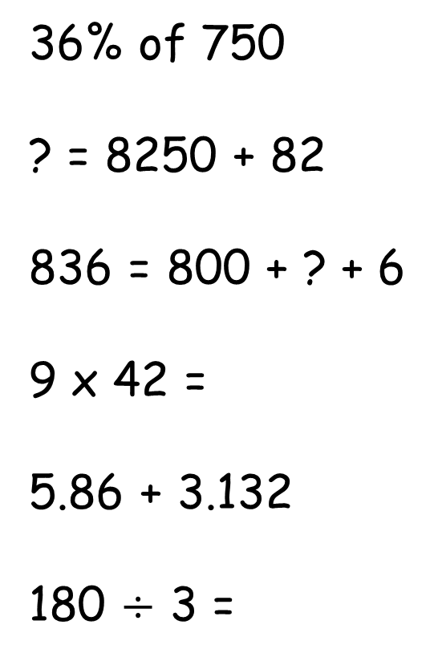
Tool Kit list
Pencil
Purple Pen
Whiteboard
Whiteboard pen
Glue
Pen
Ruler
Remember to check your tool kit has everything you need for the day.
36% of 750
? = 8250 + 82
836 = 800 + ? + 6
9 x 42 =
5.86 + 3.132
180 $÷$ 3 =
Find 10% then 1% and multiply up.
This is simple addition, the sum is just reversed.
What place value column is missing?
Long multiplication.
Line up your columns correctly to solve this as a column addition.
What times table fact could you use to help you?

Slide 6
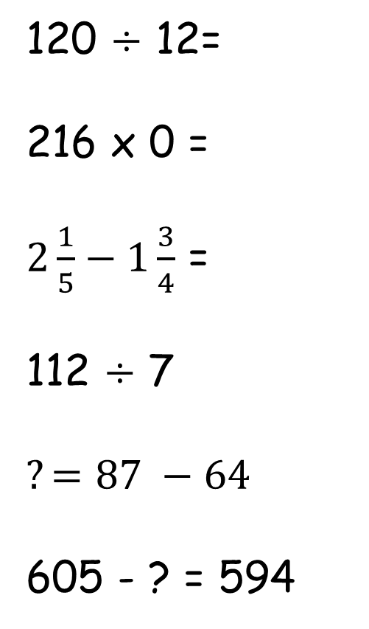
Tool Kit list
Pencil
Purple Pen
Whiteboard
Whiteboard pen
Glue
Pen
Ruler
Remember to check your tool kit has everything you need for the day.
120 $÷$ 12=
216 x 0 =
$2\frac{1}{5}−1\frac{3}{4}$ =
112 $÷$ 7
$$?=87 −64$$
605 - ? = 594
Look closely at the numbers – you may not need to work this out.
Remember what the answer ALWAYS is when we times by 0.
You will need to make the denominators the same and turn the wholes into an improper fraction.
Bus stop method.
The answer is just at the front, you can still think of this as a simple subtraction.
Could you subtract the numbers to get the missing answer?

Slide 7
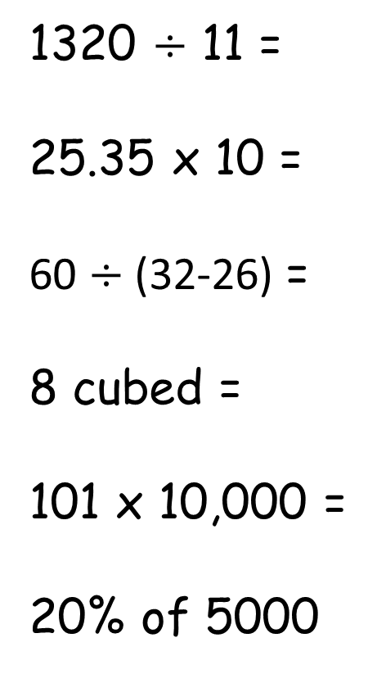
Tool Kit list
Pencil
Purple Pen
Whiteboard
Whiteboard pen
Glue
Pen
Ruler
Remember to check your tool kit has everything you need for the day.
1320 $÷$ 11 =
25.35 x 10 =
60 $÷$(32-26) =
8 cubed =
101 x 10,000 =
20% of 5000
Could you use your times table knowledge to help you solve this?
Does the decimal point move to the right or left when x by 10 – what happens to the number?
BODMAS
How many times do we times the number by itself when we cube a number?
Use your place value knowledge to help you solve this, draw a grid to help you.
Work out 10% and double it.

Slide 8
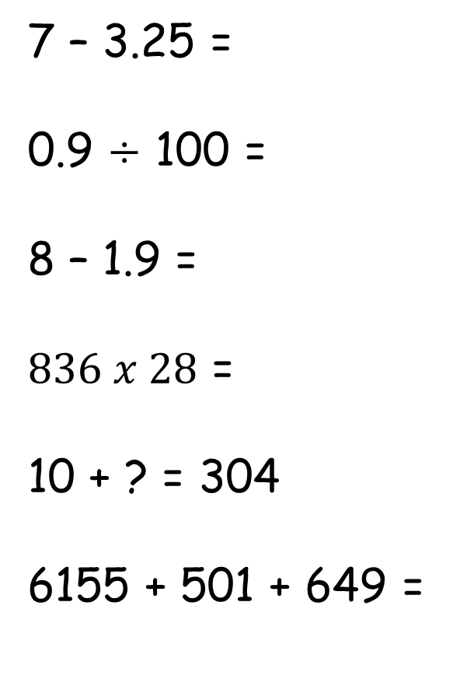
Tool Kit list
Pencil
Purple Pen
Whiteboard
Whiteboard pen
Glue
Pen
Ruler
Remember to check your tool kit has everything you need for the day.
7 – 3.25 =
0.9 $÷$ 100 =
8 – 1.9 =
$836 x 28$ =
10 + ? = 304
6155 + 501 + 649 =
Set out as column subtraction or take the whole away and then take the decimal away.
Place value – will the number get smaller or bigger, use your chart or slider to help you.
Take away the whole then take away the fraction, or use column subtraction.
Long multiplication.
Use the inverse (subtraction) to help you.
Column addition – be careful to line them up correctly.

Slide 9
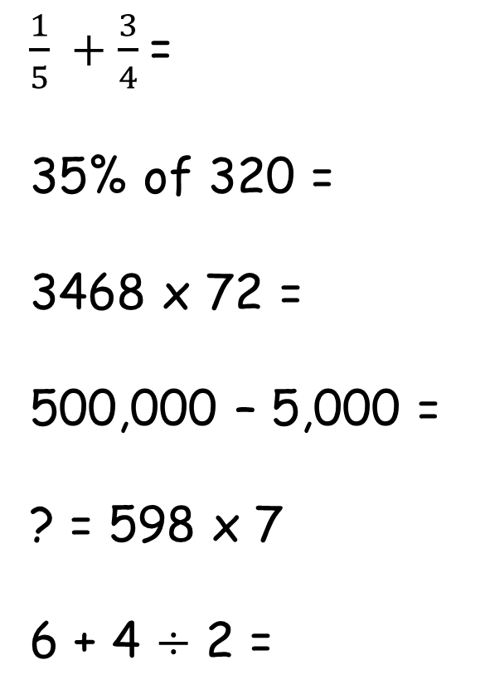
Tool Kit list
Pencil
Purple Pen
Whiteboard
Whiteboard pen
Glue
Pen
Ruler
Remember to check your tool kit has everything you need for the day.
$\frac{1}{5} +\frac{3}{4}$=
35% of 320 =
3468 x 72 =
500,000 – 5,000 =
? = 598 x 7
6 + 4 $÷$ 2 =
Make the denominators the same and then you can work this out.
Find 10% and then use this to work out 5% (by halving) and 30% (by times by 3)
Long multiplication
Use your place value knowledge or continuous difference.
Multiplication.
BODMAS

Slide 10
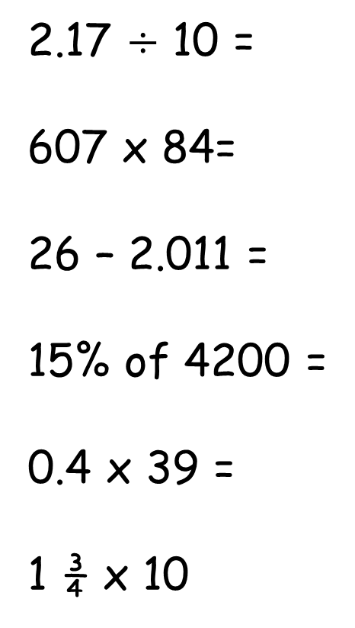
Tool Kit list
Pencil
Purple Pen
Whiteboard
Whiteboard pen
Glue
Pen
Ruler
Remember to check your tool kit has everything you need for the day.
2.17 $÷$ 10 =
607 x 84=
26 – 2.011 =
15% of 4200 =
0.4 x 39 =
1 ¾ x 10
Use your place value knowledge.
Long multiplication.
Set this out as column subtraction.
Find 10% and then use this to find 5%
Remove the decimal point and then multiply, then add the decimal point back in. Remember it needs ot have the same number of decimals places after the point.
X 1 by 10 then times ¾ by 10.

Slide 11
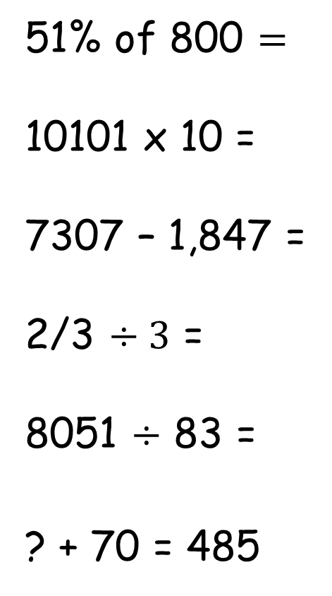
Tool Kit list
Pencil
Purple Pen
Whiteboard
Whiteboard pen
Glue
Pen
Ruler
Remember to check your tool kit has everything you need for the day.
51% of 800 $=$
10101 x 10 =
7307 – 1,847 =
2/3 $÷3$ =
8051 $÷$ 83 =
? + 70 = 485
Find 10% and then find 1%
We move columns to the left when we multiply by 10.
Column subtraction.
When we divide a fraction, the fraction gets smaller.
Bus stop method.
Think of the part part whole model.

Slide 12
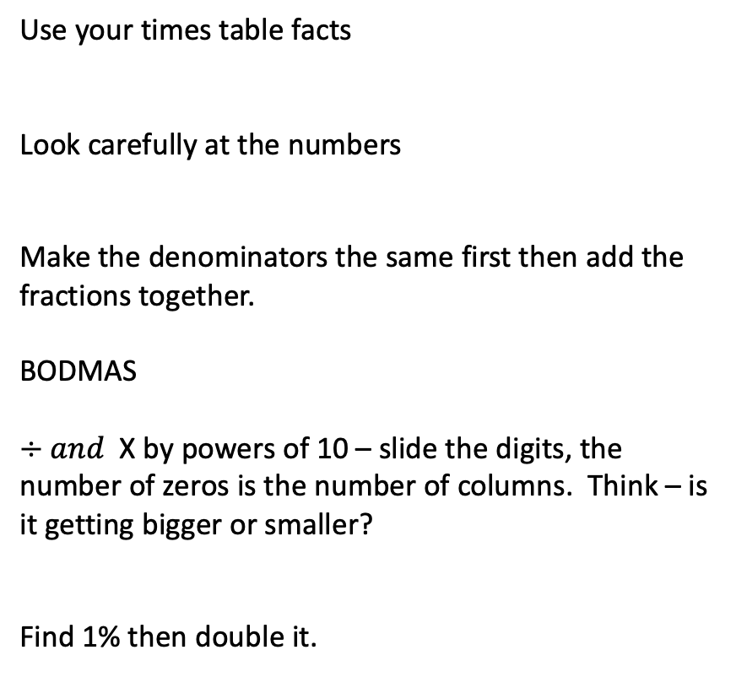
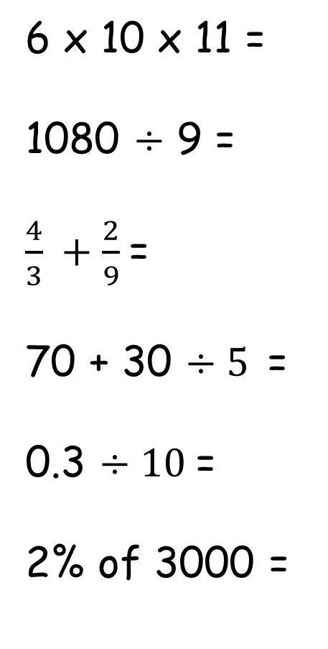
Tool Kit list
Pencil
Purple Pen
Whiteboard
Whiteboard pen
Glue
Pen
Ruler
Remember to check your tool kit has everything you need for the day.
6 x 10 x 11 =
1080 $÷$ 9 =
$\frac{4}{3} +\frac{2}{9}$=
70 + 30 $÷5$=
0.3 $÷10$=
2% of 3000 =
Use your times table facts
Look carefully at the numbers
Make the denominators the same first then add the fractions together.
BODMAS
$÷and$X by powers of 10 – slide the digits, the number of zeros is the number of columns. Think – is it getting bigger or smaller?
Find 1% then double it.

Slide 13
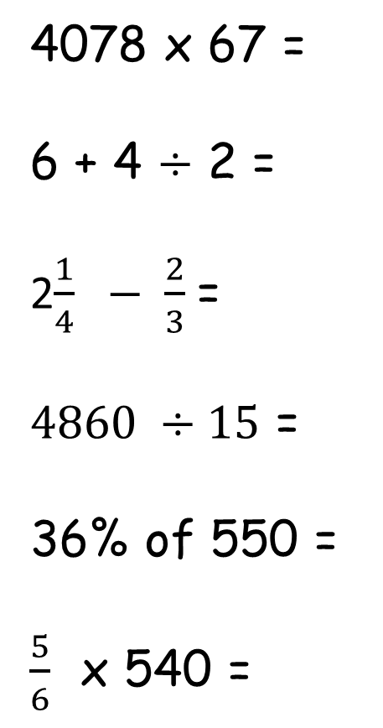
Tool Kit list
Pencil
Purple Pen
Whiteboard
Whiteboard pen
Glue
Pen
Ruler
Remember to check your tool kit has everything you need for the day.
4078 x 67 =
6 + 4 $÷$ 2 =
2$\frac{1}{4} − \frac{2}{3}$=
$4860 ÷15$ =
36% of 550 =
$\frac{5}{6}$ x 540 =
Long multiplication.
BODMAS
Turn it into an improper fraction, then make the denominators the same.
Long division.
Find 10% then find 1% and then work it out from there.
Use your timetables knowledge.

Slide 14
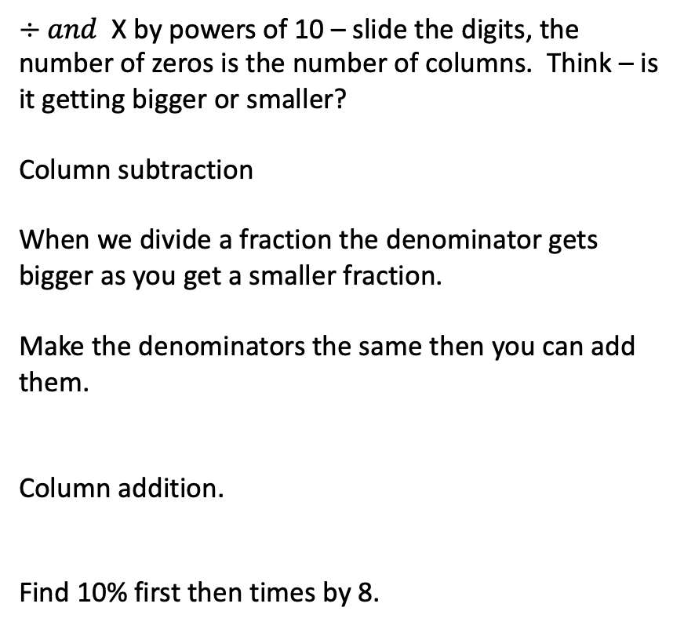
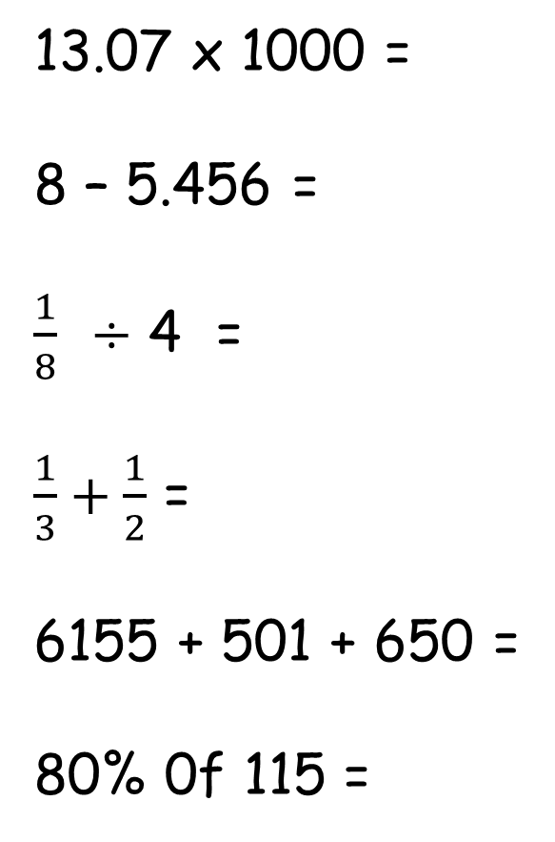
Tool Kit list
Pencil
Purple Pen
Whiteboard
Whiteboard pen
Glue
Pen
Ruler
Remember to check your tool kit has everything you need for the day.
13.07 x 1000 =
8 – 5.456 =
$\frac{1}{8}$ $÷$ 4 =
$\frac{1}{3}+\frac{1}{2}$ =
6155 + 501 + 650 =
80% 0f 115 =
$÷and$X by powers of 10 – slide the digits, the number of zeros is the number of columns. Think – is it getting bigger or smaller?
Column subtraction
When we divide a fraction the denominator gets bigger as you get a smaller fraction.
Make the denominators the same then you can add them.
Column addition.
Find 10% first then times by 8.

Slide 15
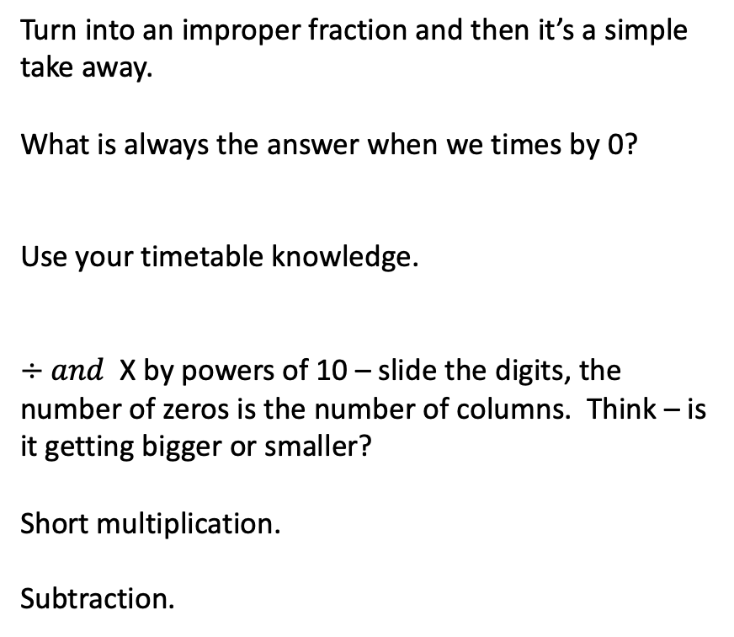
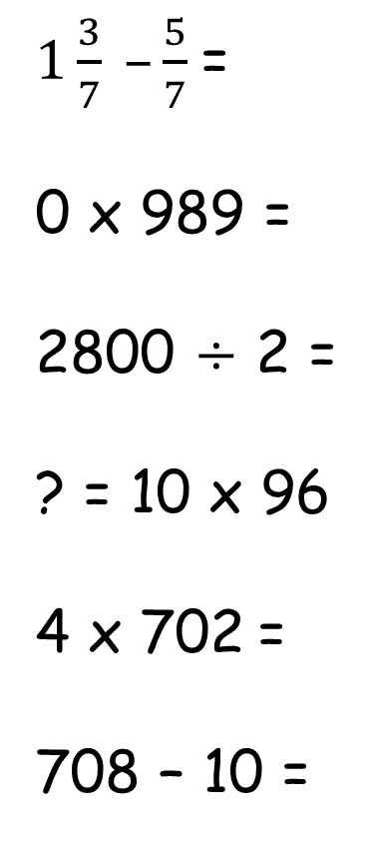
Tool Kit list
Pencil
Purple Pen
Whiteboard
Whiteboard pen
Glue
Pen
Ruler
Remember to check your tool kit has everything you need for the day.
$1\frac{3}{7} –\frac{5}{7}$=
0 x 989 =
2800 $÷$ 2 =
? = 10 x 96
4 x 702 =
708 – 10 =
Turn into an improper fraction and then it’s a simple take away.
What is always the answer when we times by 0?
Use your timetable knowledge.
$÷and$X by powers of 10 – slide the digits, the number of zeros is the number of columns. Think – is it getting bigger or smaller?
Short multiplication.
Subtraction.

Slide 16
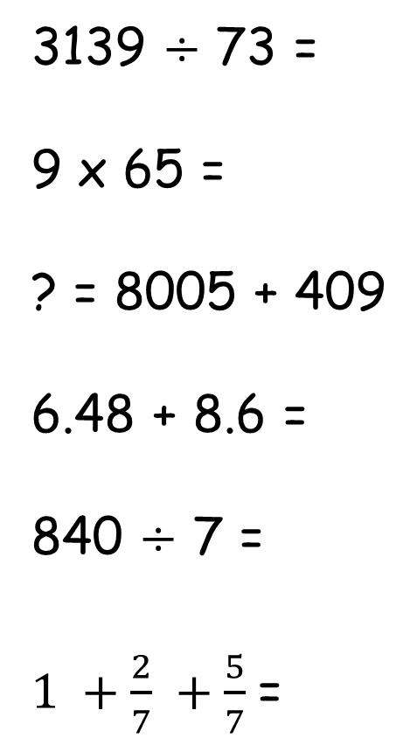
Tool Kit list
Pencil
Purple Pen
Whiteboard
Whiteboard pen
Glue
Pen
Ruler
Remember to check your tool kit has everything you need for the day.
3139 $÷$ 73 =
9 x 65 =
? = 8005 + 409
6.48 + 8.6 =
840 $÷$ 7 =
$1 +\frac{2}{7} +\frac{5}{7}$=
Bus stop method – long division.
Short multiplication.
Column addition.
Line up the decimals in columns correctly.
Use your times table facts.
Add the fractions then add to the whole.

Slide 17
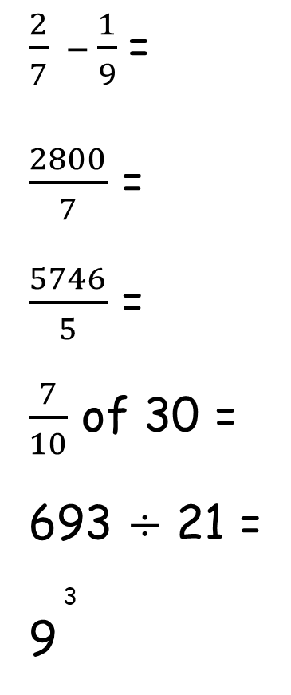
Tool Kit list
Pencil
Purple Pen
Whiteboard
Whiteboard pen
Glue
Pen
Ruler
Remember to check your tool kit has everything you need for the day.
$\frac{2}{7} –\frac{1}{9}$=
$\frac{2800}{7}$ =
$\frac{5746}{5}$ =
$\frac{7}{10}$ of 30 =
693 $÷$ 21 =
3
9
Make the denominators the same then work out the subtraction.
Use your times table knowledge.
Short division.
Divide 30 by the denominator and then multiply it by the numerator.
Bus stop method. Can you use factor pairs and short division?
How many times do we times 9 by?

Slide 18
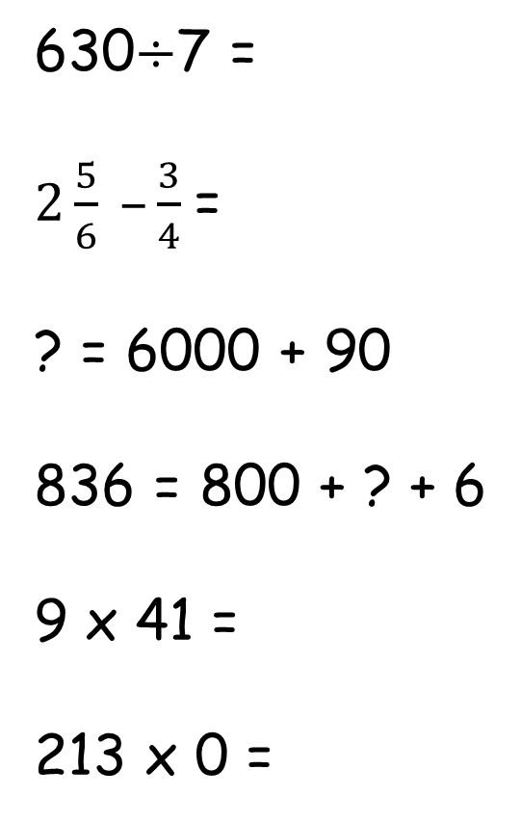
Tool Kit list
Pencil
Purple Pen
Whiteboard
Whiteboard pen
Glue
Pen
Ruler
Remember to check your tool kit has everything you need for the day.
630$÷$7 =
$2\frac{5}{6} –\frac{3}{4}$=
? = 6000 + 90
836 = 800 + ? + 6
9 x 41 =
213 x 0 =
Use your times table knowledge.
Turn it into an improper fraction and then make the denominators the same.
You don’t need to work this out – think about which columns will change.
Which place value column is missing?
Short multiplication.
What is always the answer when we multiply by 0.

Slide 19
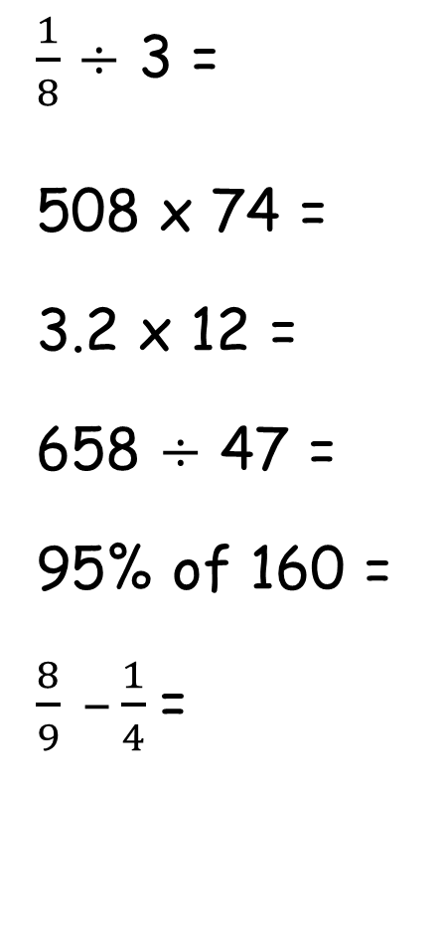
Tool Kit list
Pencil
Purple Pen
Whiteboard
Whiteboard pen
Glue
Pen
Ruler
Remember to check your tool kit has everything you need for the day.
$\frac{1}{8}$ $÷$ 3 =
508 x 74 =
3.2 x 12 =
658 $÷$ 47 =
95% of 160 =
$\frac{8}{9} –\frac{1}{4}$=
When we divide a fraction the denominator gets bigger as you get a smaller fraction.
Long multiplication.
Remove the decimal, long multiplication then add the decimal back in (remembering how many place holders after the decimal there are).
Long division – Bus stop.
Find 5% and take that number away from the whole.
Make the denominators the same then work out the subtraction.

Slide 20
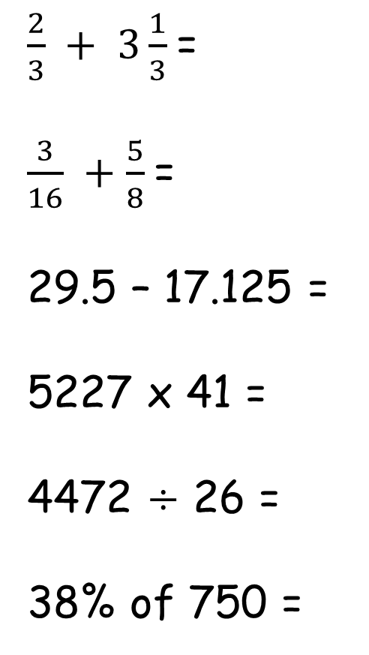
Tool Kit list
Pencil
Purple Pen
Whiteboard
Whiteboard pen
Glue
Pen
Ruler
Remember to check your tool kit has everything you need for the day.
$\frac{2}{3} + 3\frac{1}{3}$=
$\frac{3}{16} +\frac{5}{8}$=
29.5 – 17.125 =
5227 x 41 =
4472 $÷$ 26 =
38% of 750 =
Change into an improper fraction and then add the fractions together.
Make the denominators the same first.
Column subtraction – line up the decimals.
Long multiplication.
Can you remember the strategies to work out the 26 times table – then use bus stop, long division.
Find 10% then 1% and work out from there.

Slide 21
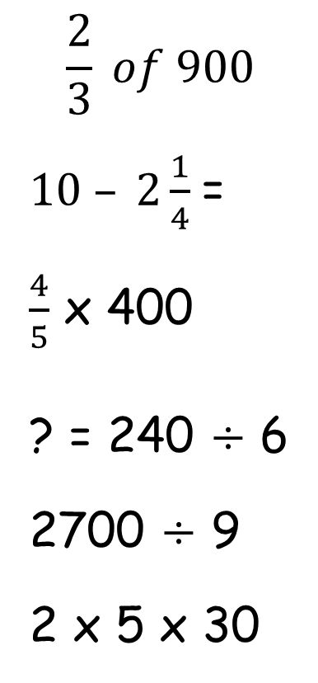
Tool Kit list
Pencil
Purple Pen
Whiteboard
Whiteboard pen
Glue
Pen
Ruler
Remember to check your tool kit has everything you need for the day.
$$\frac{2}{3} of 900$$
$10 – 2\frac{1}{4}$=
$\frac{4}{5}$ x 400
? = 240 $÷$ 6
2700 $÷$ 9
2 x 5 x 30
Find 1 third first and then double it to find 2 thirds.
Take away the whole and then take away the fraction.
What is 1 fifth? Work this out then you need 4 lots of that answer.
Bus stop method – short division.
Use your timestable knowledge.
Multiply first 2 digits then multiply the answer by the third number.

Slide 22
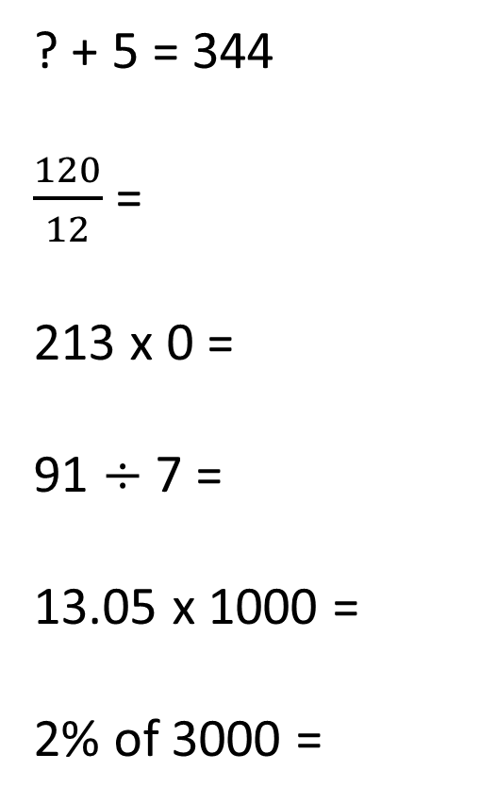
Tool Kit list
Pencil
Purple Pen
Whiteboard
Whiteboard pen
Glue
Pen
Ruler
Remember to check your tool kit has everything you need for the day.
? + 5 = 344
$\frac{120}{12}$ =
213 x 0 =
91 $÷$ 7 =
13.05 x 1000 =
2% of 3000 =
Use the inverse.
Use your timestable knowledge.
What is always the answer when we times by 0.
Short division.
How many columns will the number need to move when we x by 1000?
Find 1% and double it.

Slide 23
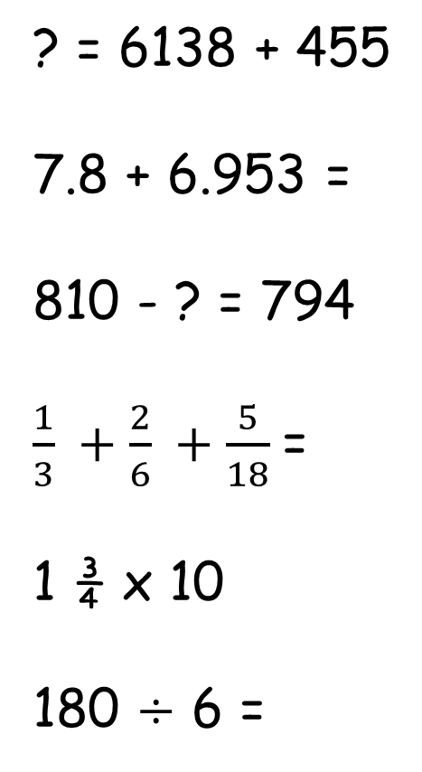
Tool Kit list
Pencil
Purple Pen
Whiteboard
Whiteboard pen
Glue
Pen
Ruler
Remember to check your tool kit has everything you need for the day.
? = 6138 + 455
7.8 + 6.953 =
810 - ? = 794
$\frac{1}{3} +\frac{2}{6} +\frac{5}{18}$=
1 ¾ x 10
180 $÷$ 6 =
Formal addition
Line up the columns correctly.
How could you use the two numbers you have to work out the missing value?
Remember that all the denominators will need to be the same before we can solve this.
Times the whole number by 10 then times the fraction. Could a pictoral representation help you?
What timestable could you use to help you?

Slide 24
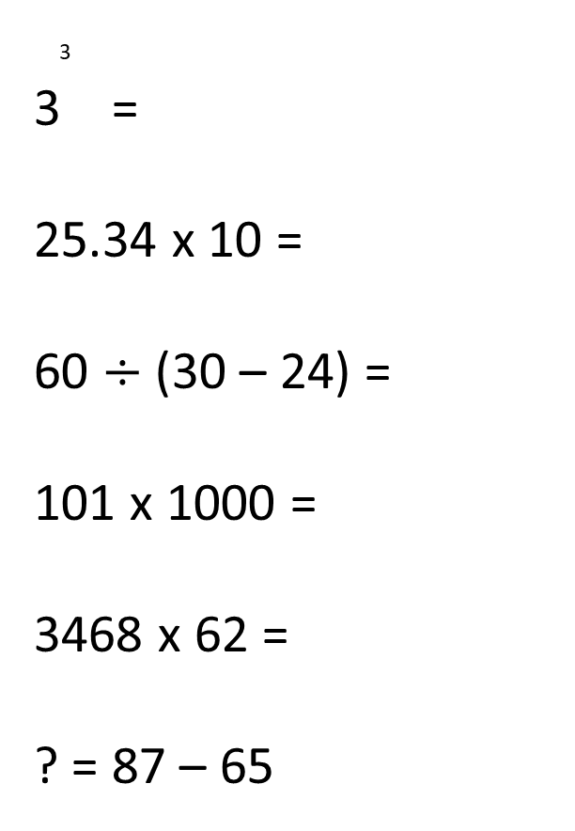
Tool Kit list
Pencil
Purple Pen
Whiteboard
Whiteboard pen
Glue
Pen
Ruler
Remember to check your tool kit has everything you need for the day.
3
3 =
25.34 x 10 =
60 $÷$ (30 – 24) =
101 x 1000 =
3468 x 62 =
? = 87 – 65
3 x 3 x 3
How many columns will it move when we times by 10?
BODMAS
Think about how many columns this will move.
Long multiplication.
Simple subtraction but the answer is first.

Slide 25
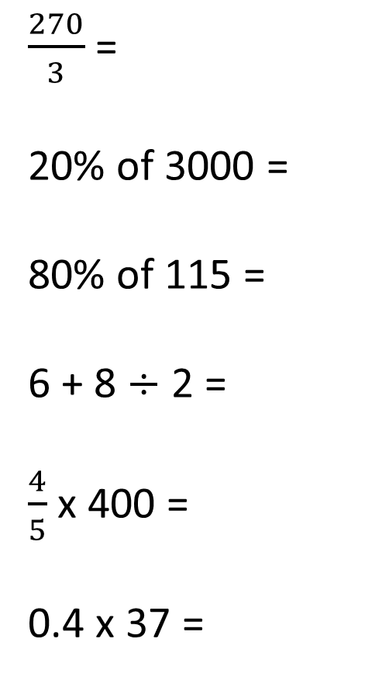
Tool Kit list
Pencil
Purple Pen
Whiteboard
Whiteboard pen
Glue
Pen
Ruler
Remember to check your tool kit has everything you need for the day.
$\frac{270}{3}$=
20% of 3000 =
80% of 115 =
6 + 8 $÷$ 2 =
$\frac{4}{5}$ x 400 =
0.4 x 37 =
Use your knowledge of your three times table.
Find 10 % and then double it.
Find 10% and then times it by 8.
BODMAS
This is the same as saying 4/5 of 400 – find 1 fifth first.
Remove the decimals work out the multiplication then put the decimal back in.

Slide 26
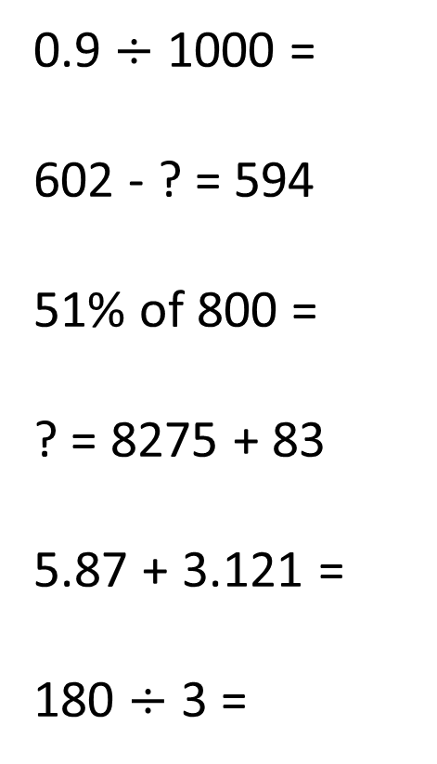
Tool Kit list
Pencil
Purple Pen
Whiteboard
Whiteboard pen
Glue
Pen
Ruler
Remember to check your tool kit has everything you need for the day.
0.9 $÷$ 1000 =
602 - ? = 594
51% of 800 =
? = 8275 + 83
5.87 + 3.121 =
180 $÷$ 3 =
How many columns will this number move?
Can you use the numbers you have to work out the missing value? Think part part whole model.
Find 10% and 1% first then times the 10% to get to 50%
Column addition.
Line up the decimals correctly.
Can you use your timestables to help you with this.

Slide 27
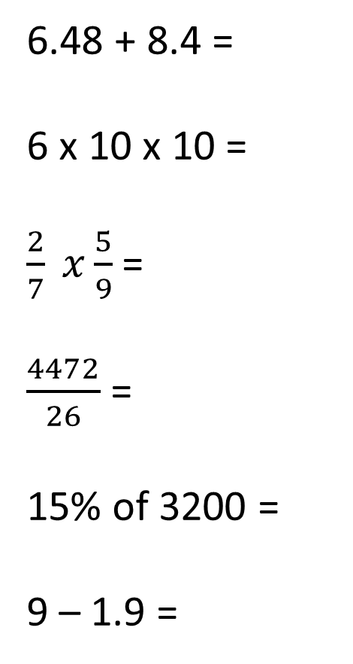
Tool Kit list
Pencil
Purple Pen
Whiteboard
Whiteboard pen
Glue
Pen
Ruler
Remember to check your tool kit has everything you need for the day.
6.48 + 8.4 =
6 x 10 x 10 =
$\frac{2}{7} x\frac{5}{9}$=
$\frac{4472}{26}$=
15% of 3200 =
9 – 1.9 =
Line up the decimal places.
Could you just times by 100? Why does this work?
Multiple the numerators together, and multiply the denominators together.
Long division. Can you use factor pairs?
Find 10% then work out 5%.
Column subtraction.

Slide 28
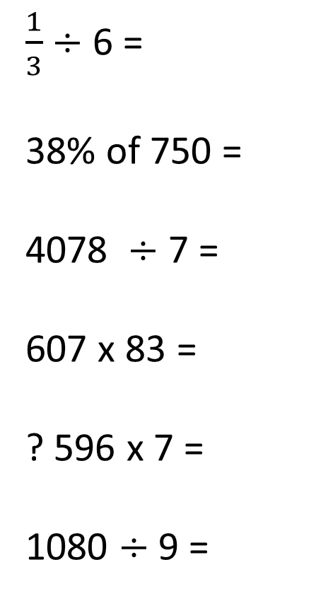
Tool Kit list
Pencil
Purple Pen
Whiteboard
Whiteboard pen
Glue
Pen
Ruler
Remember to check your tool kit has everything you need for the day.
$\frac{1}{3}$ $÷$ 6 =
38% of 750 =
4078 $÷$ 7 =
607 x 83 =
? 596 x 7 =
1080 $÷$ 9 =
Remember the denominator gets bigger even though we are dividing the fraction.
Find 10% and then find 1% how will this help you?
Bus stop method.
Long Multiplication.
Short multiplication.
Use your timestable knowledge.

